Slide 1
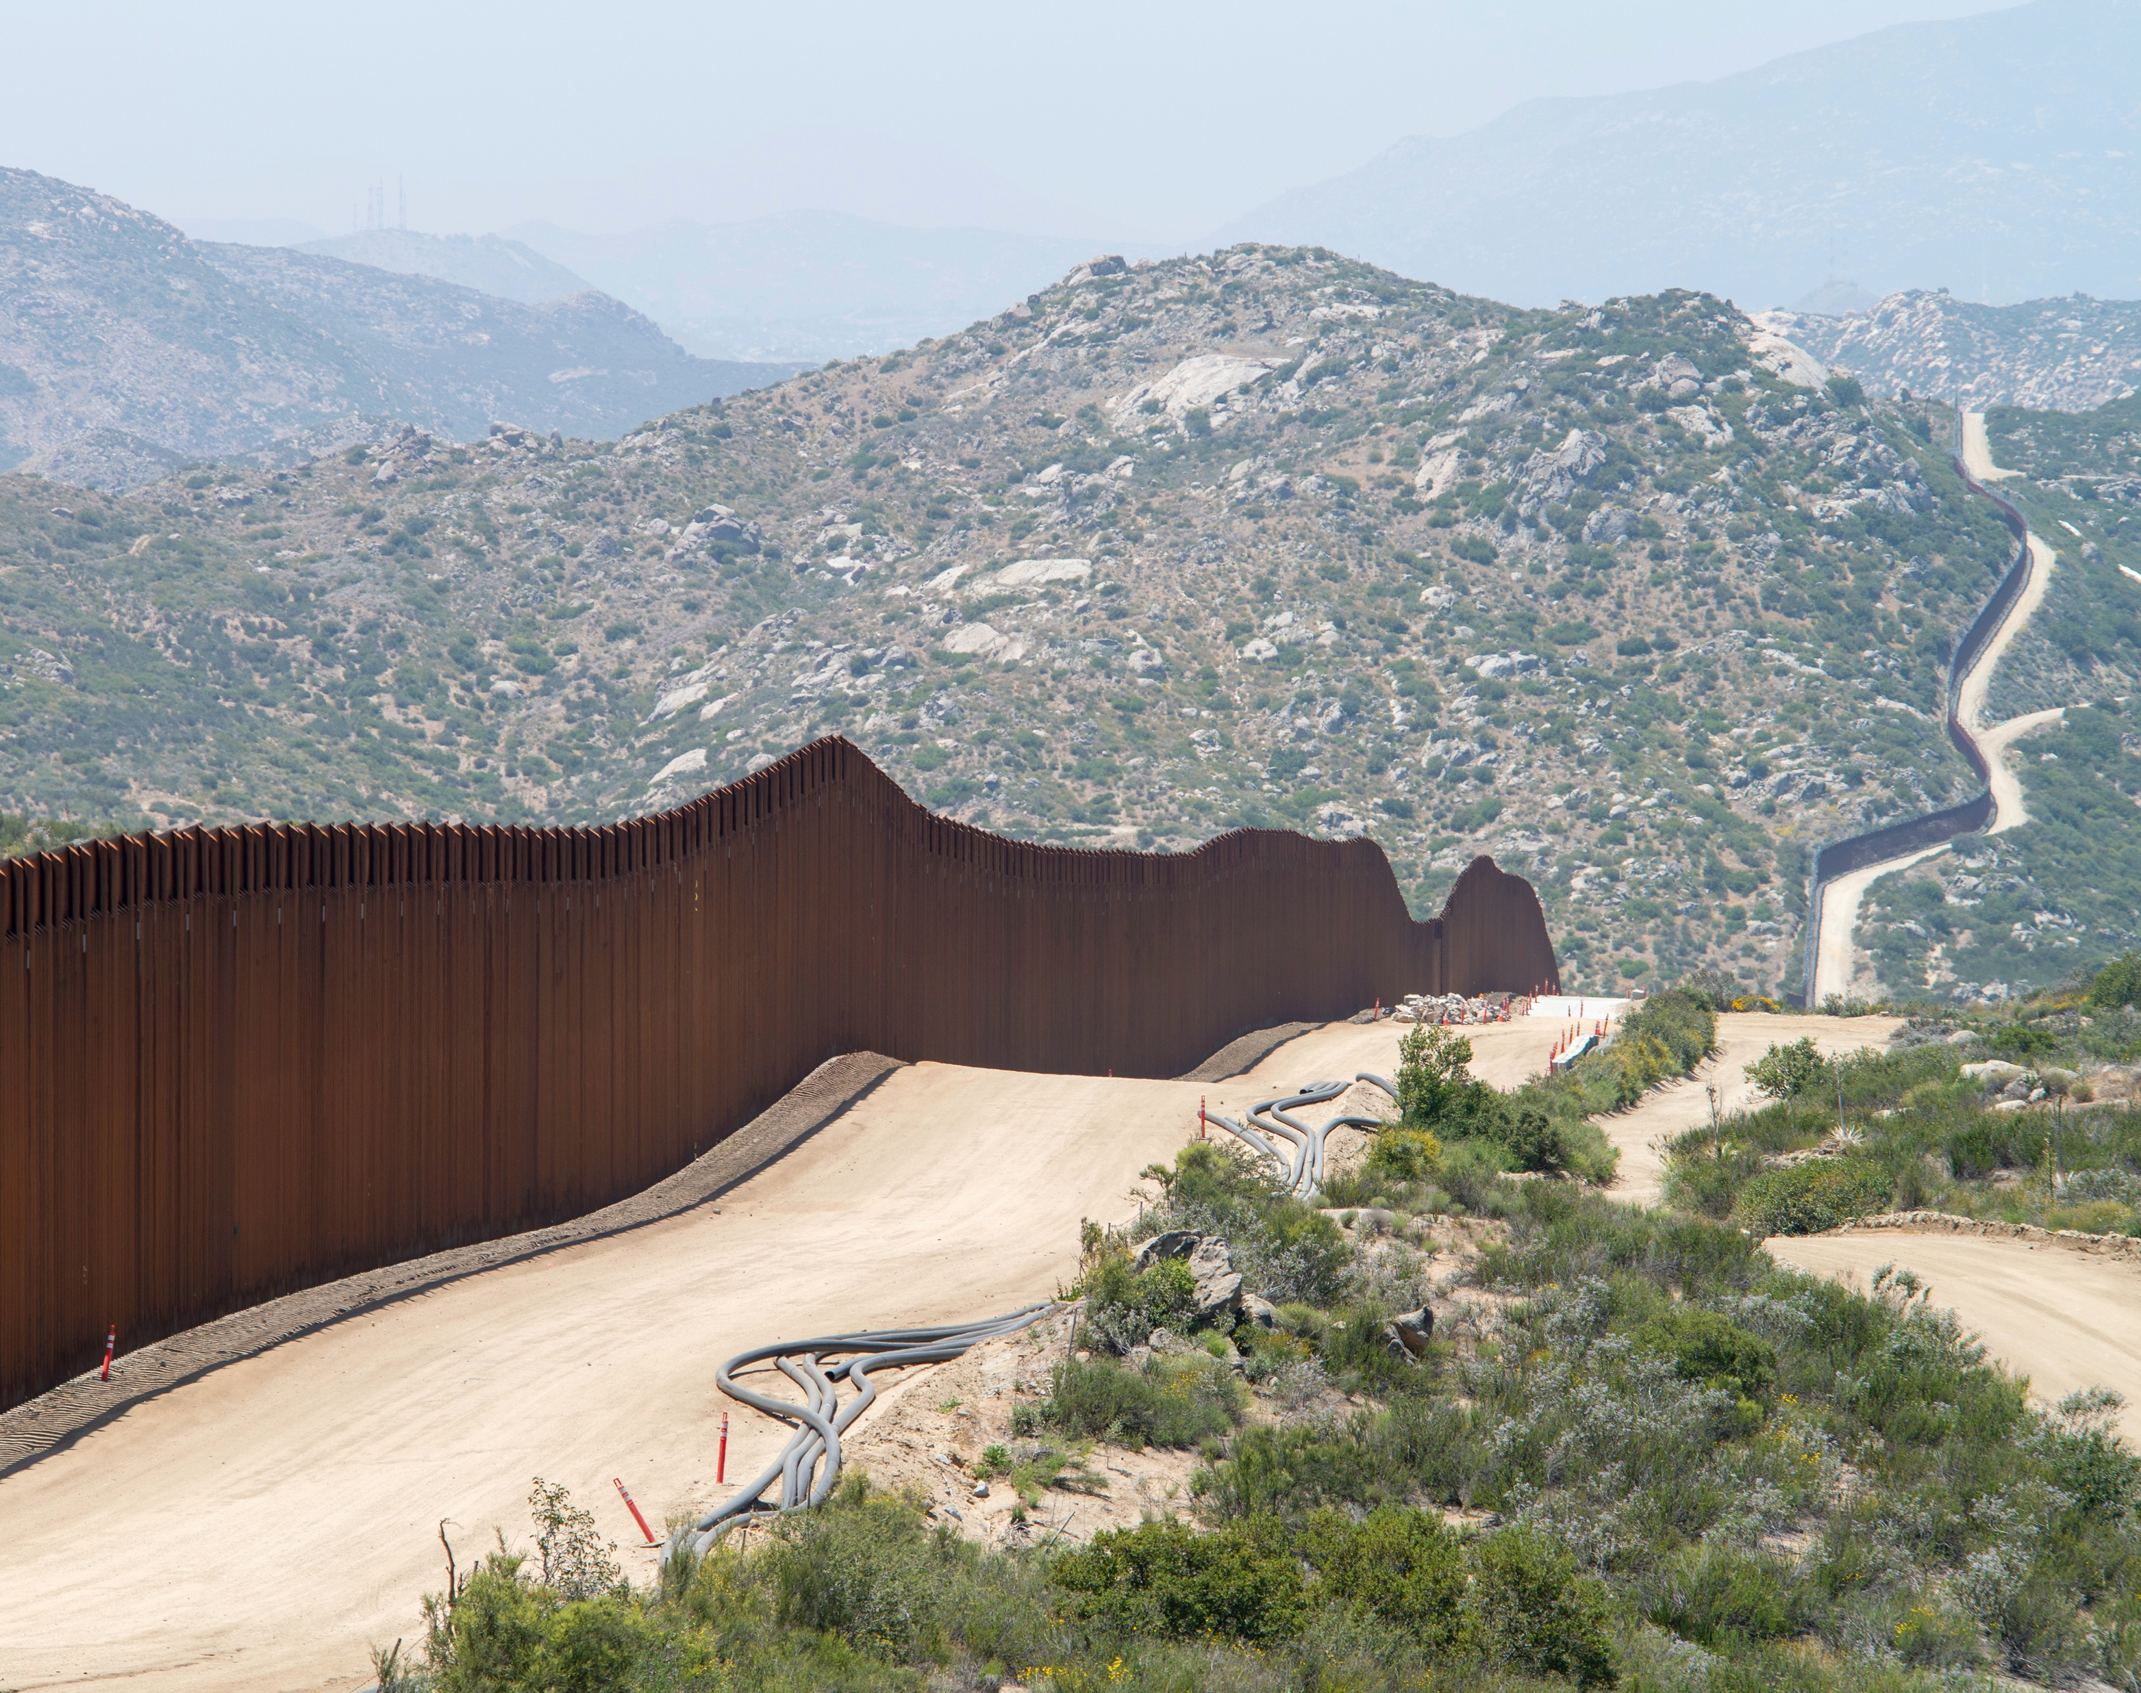
A welcoming environment
Vaughan Jones
Union Chapel

Slide 2
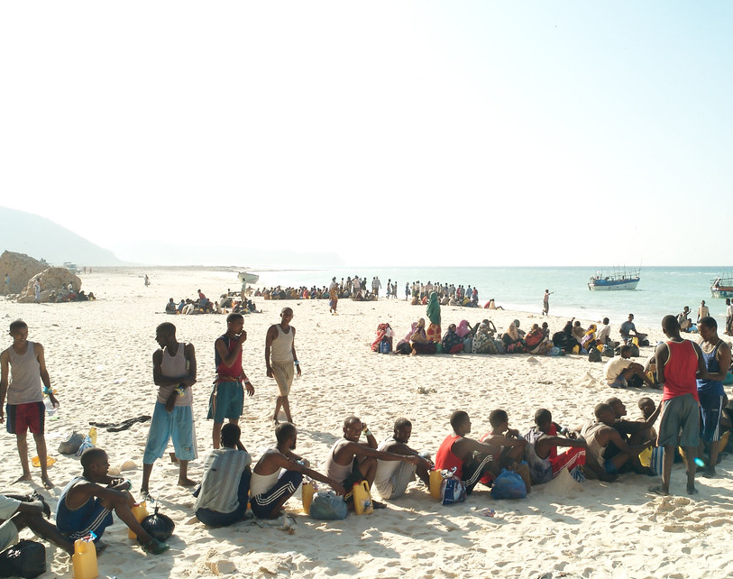
A welcoming environment
Asylum as a space;
Asylum as an ecology;
Key actors and the part they play;
The role of Christians in the transformation of a hostile to a welcoming environment; and
Some theological principles underlying our involvement.
Photo: Alixandra Fazzina/UNHCR

Slide 3
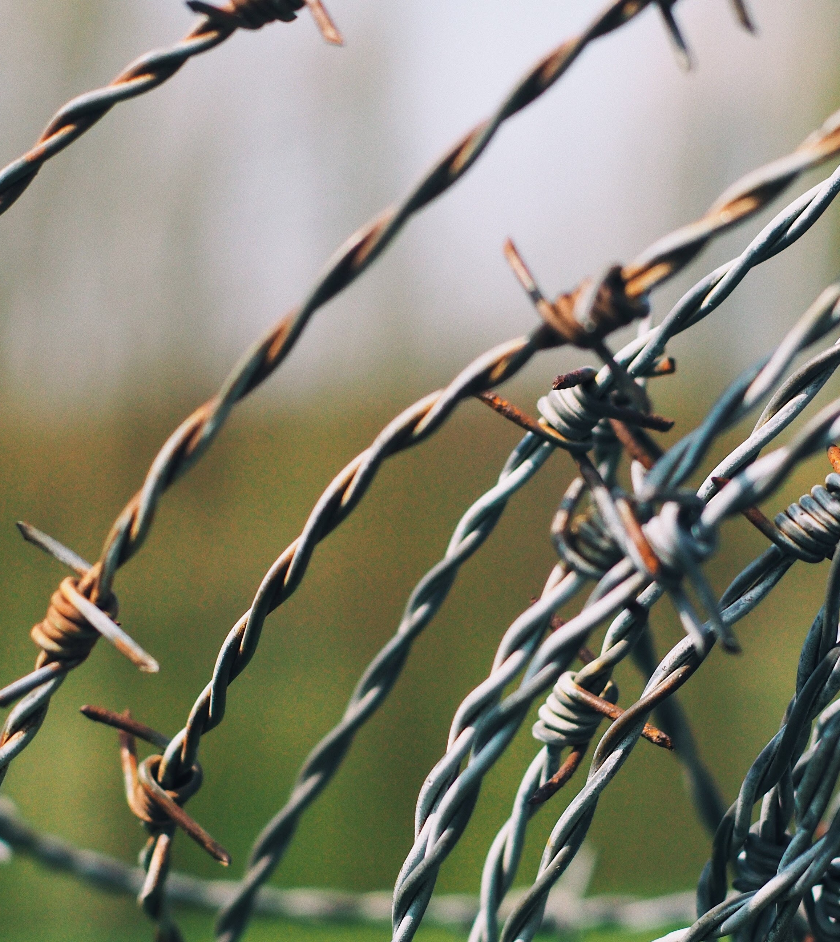
Defining asylum
Asylum is the space, within which there is protection for people who live under violence, intimidation, threat, exploitation and abuse and those who have no alternative but to leave their homes and/or countries as a result of environmental degradation. This space is geographical, communal, liminal and spiritual, rooted in the principles of fundamental human rights. It ensures safe and accessible, non-discriminatory entry points, a place of safety, and pathways to settlement or freely chosen return, always respecting the agency of those who need or are within this space.

Slide 4
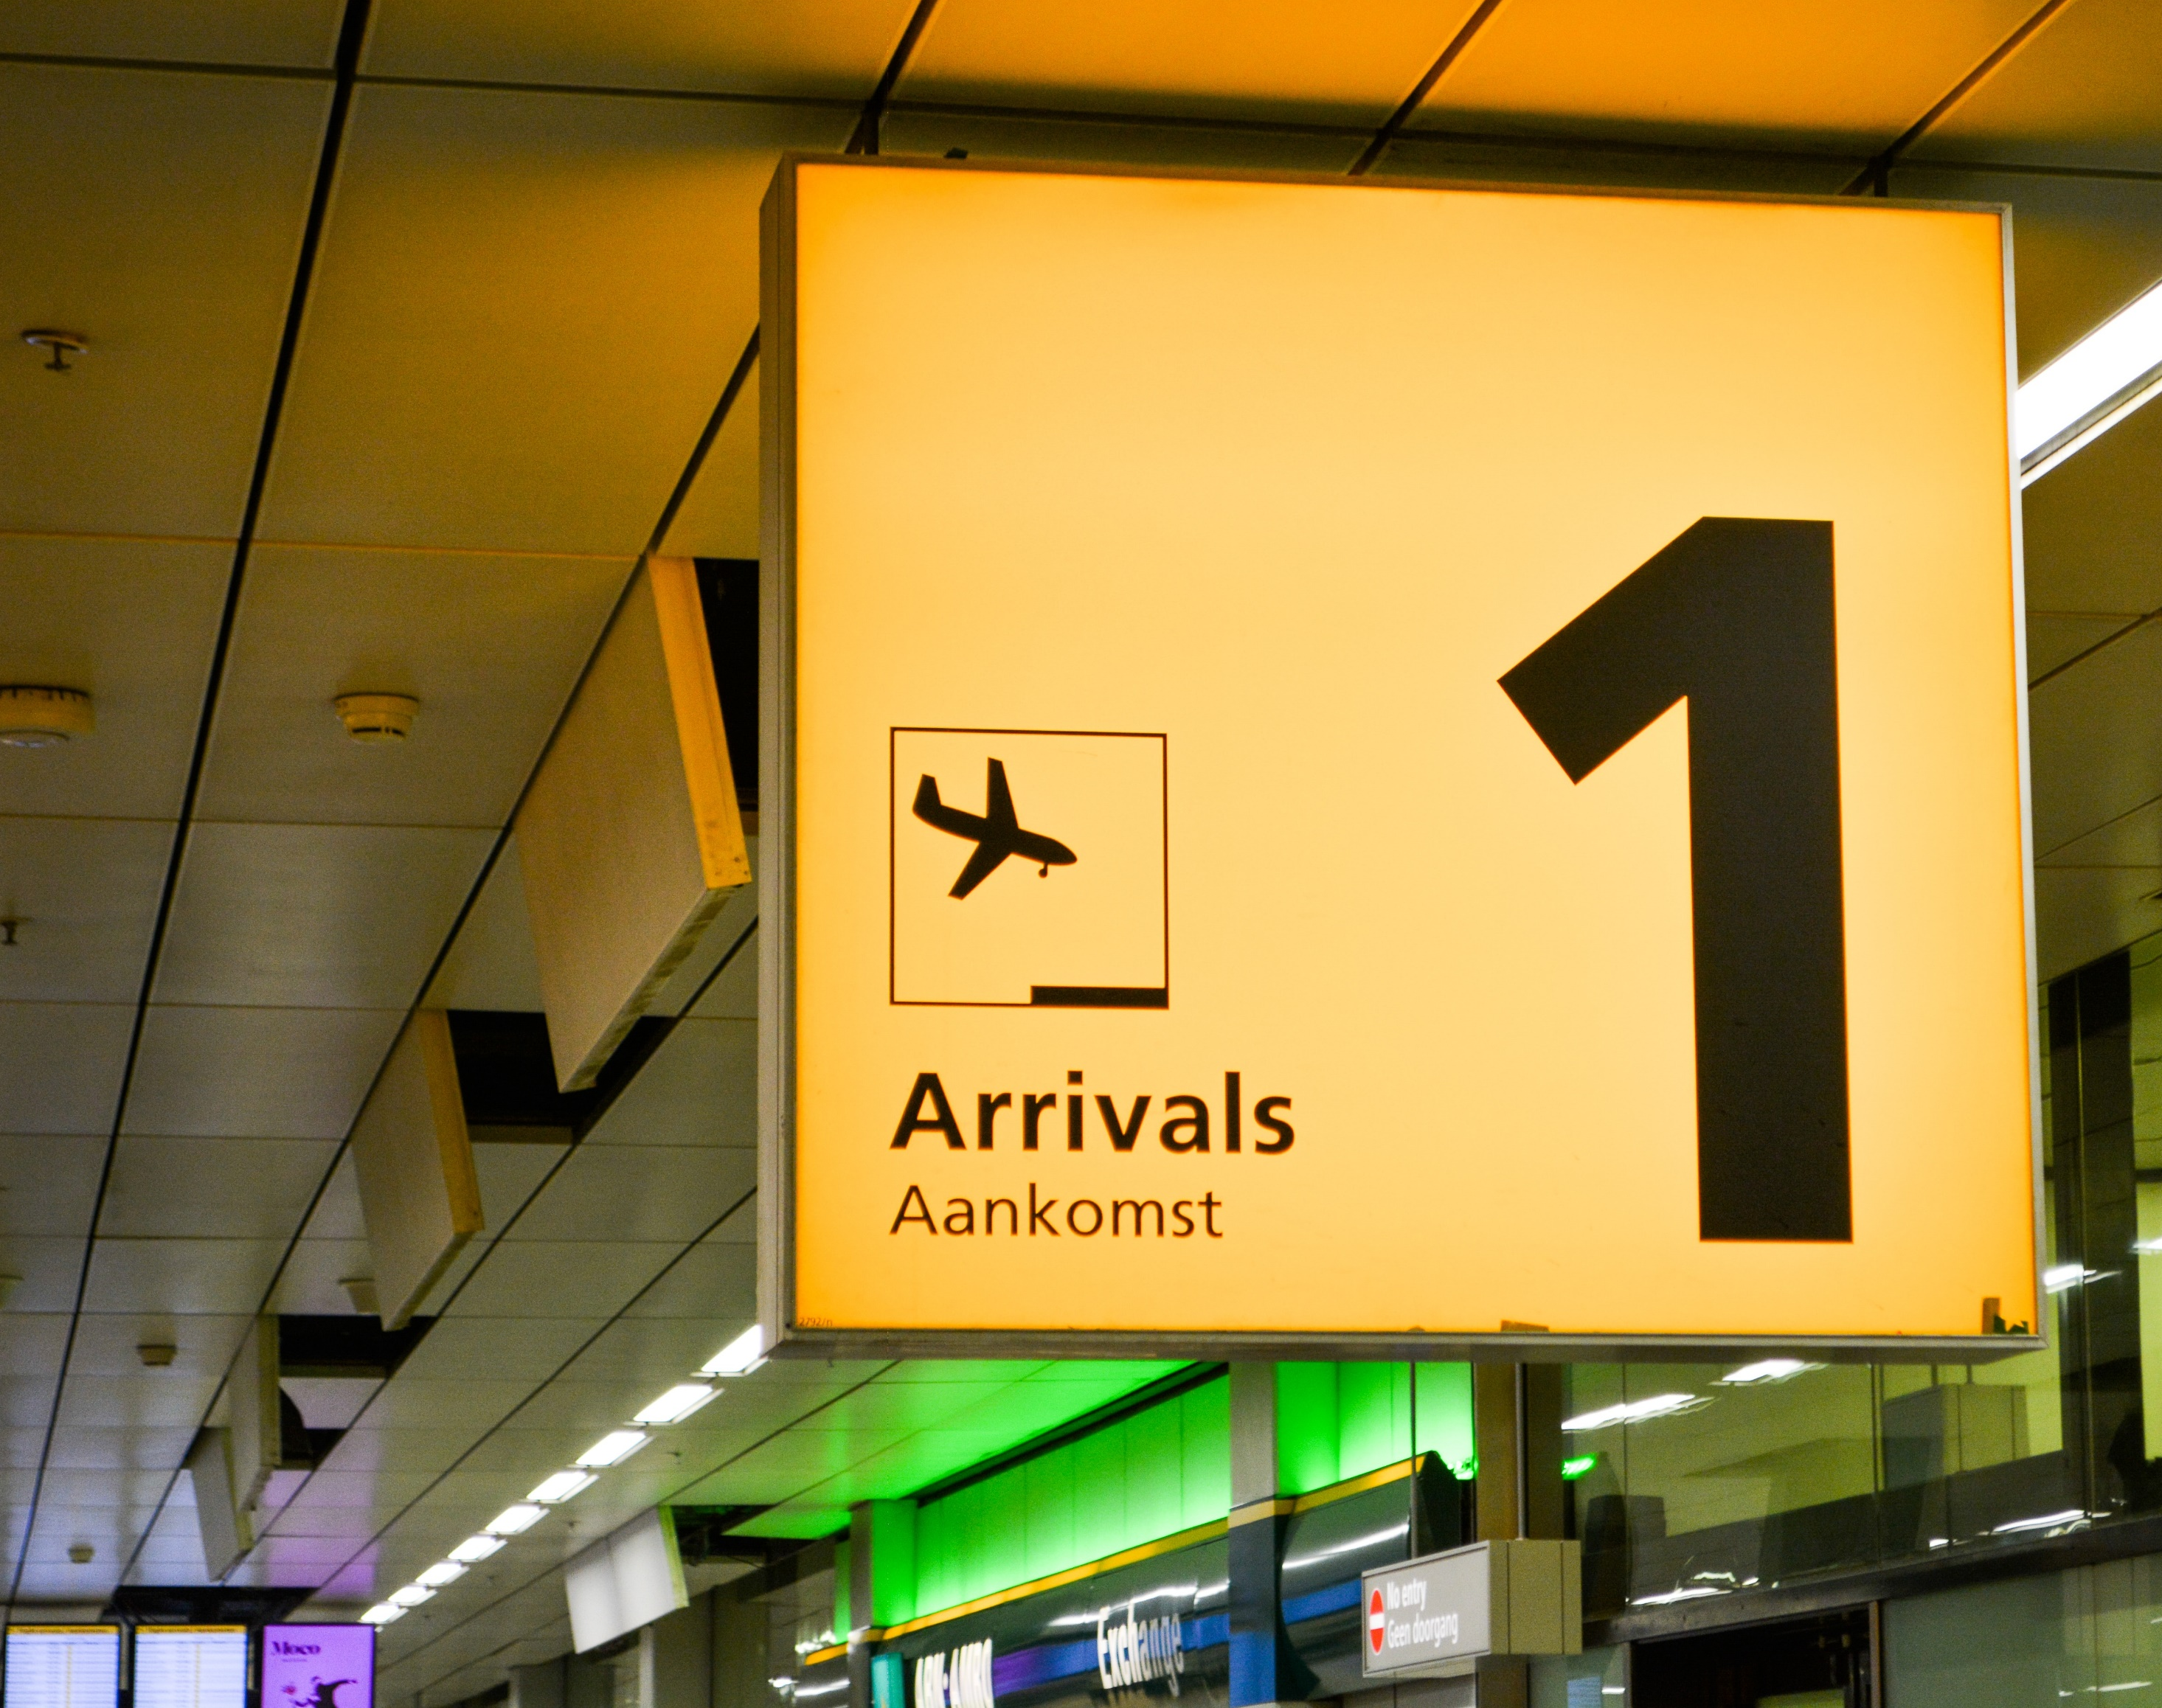
Key actors in the asylum space
State and inter-state governmental, legal and quasi-legal institutions;
Economic interests;
Civil Society; and
People who claim their asylum rights.

Slide 5
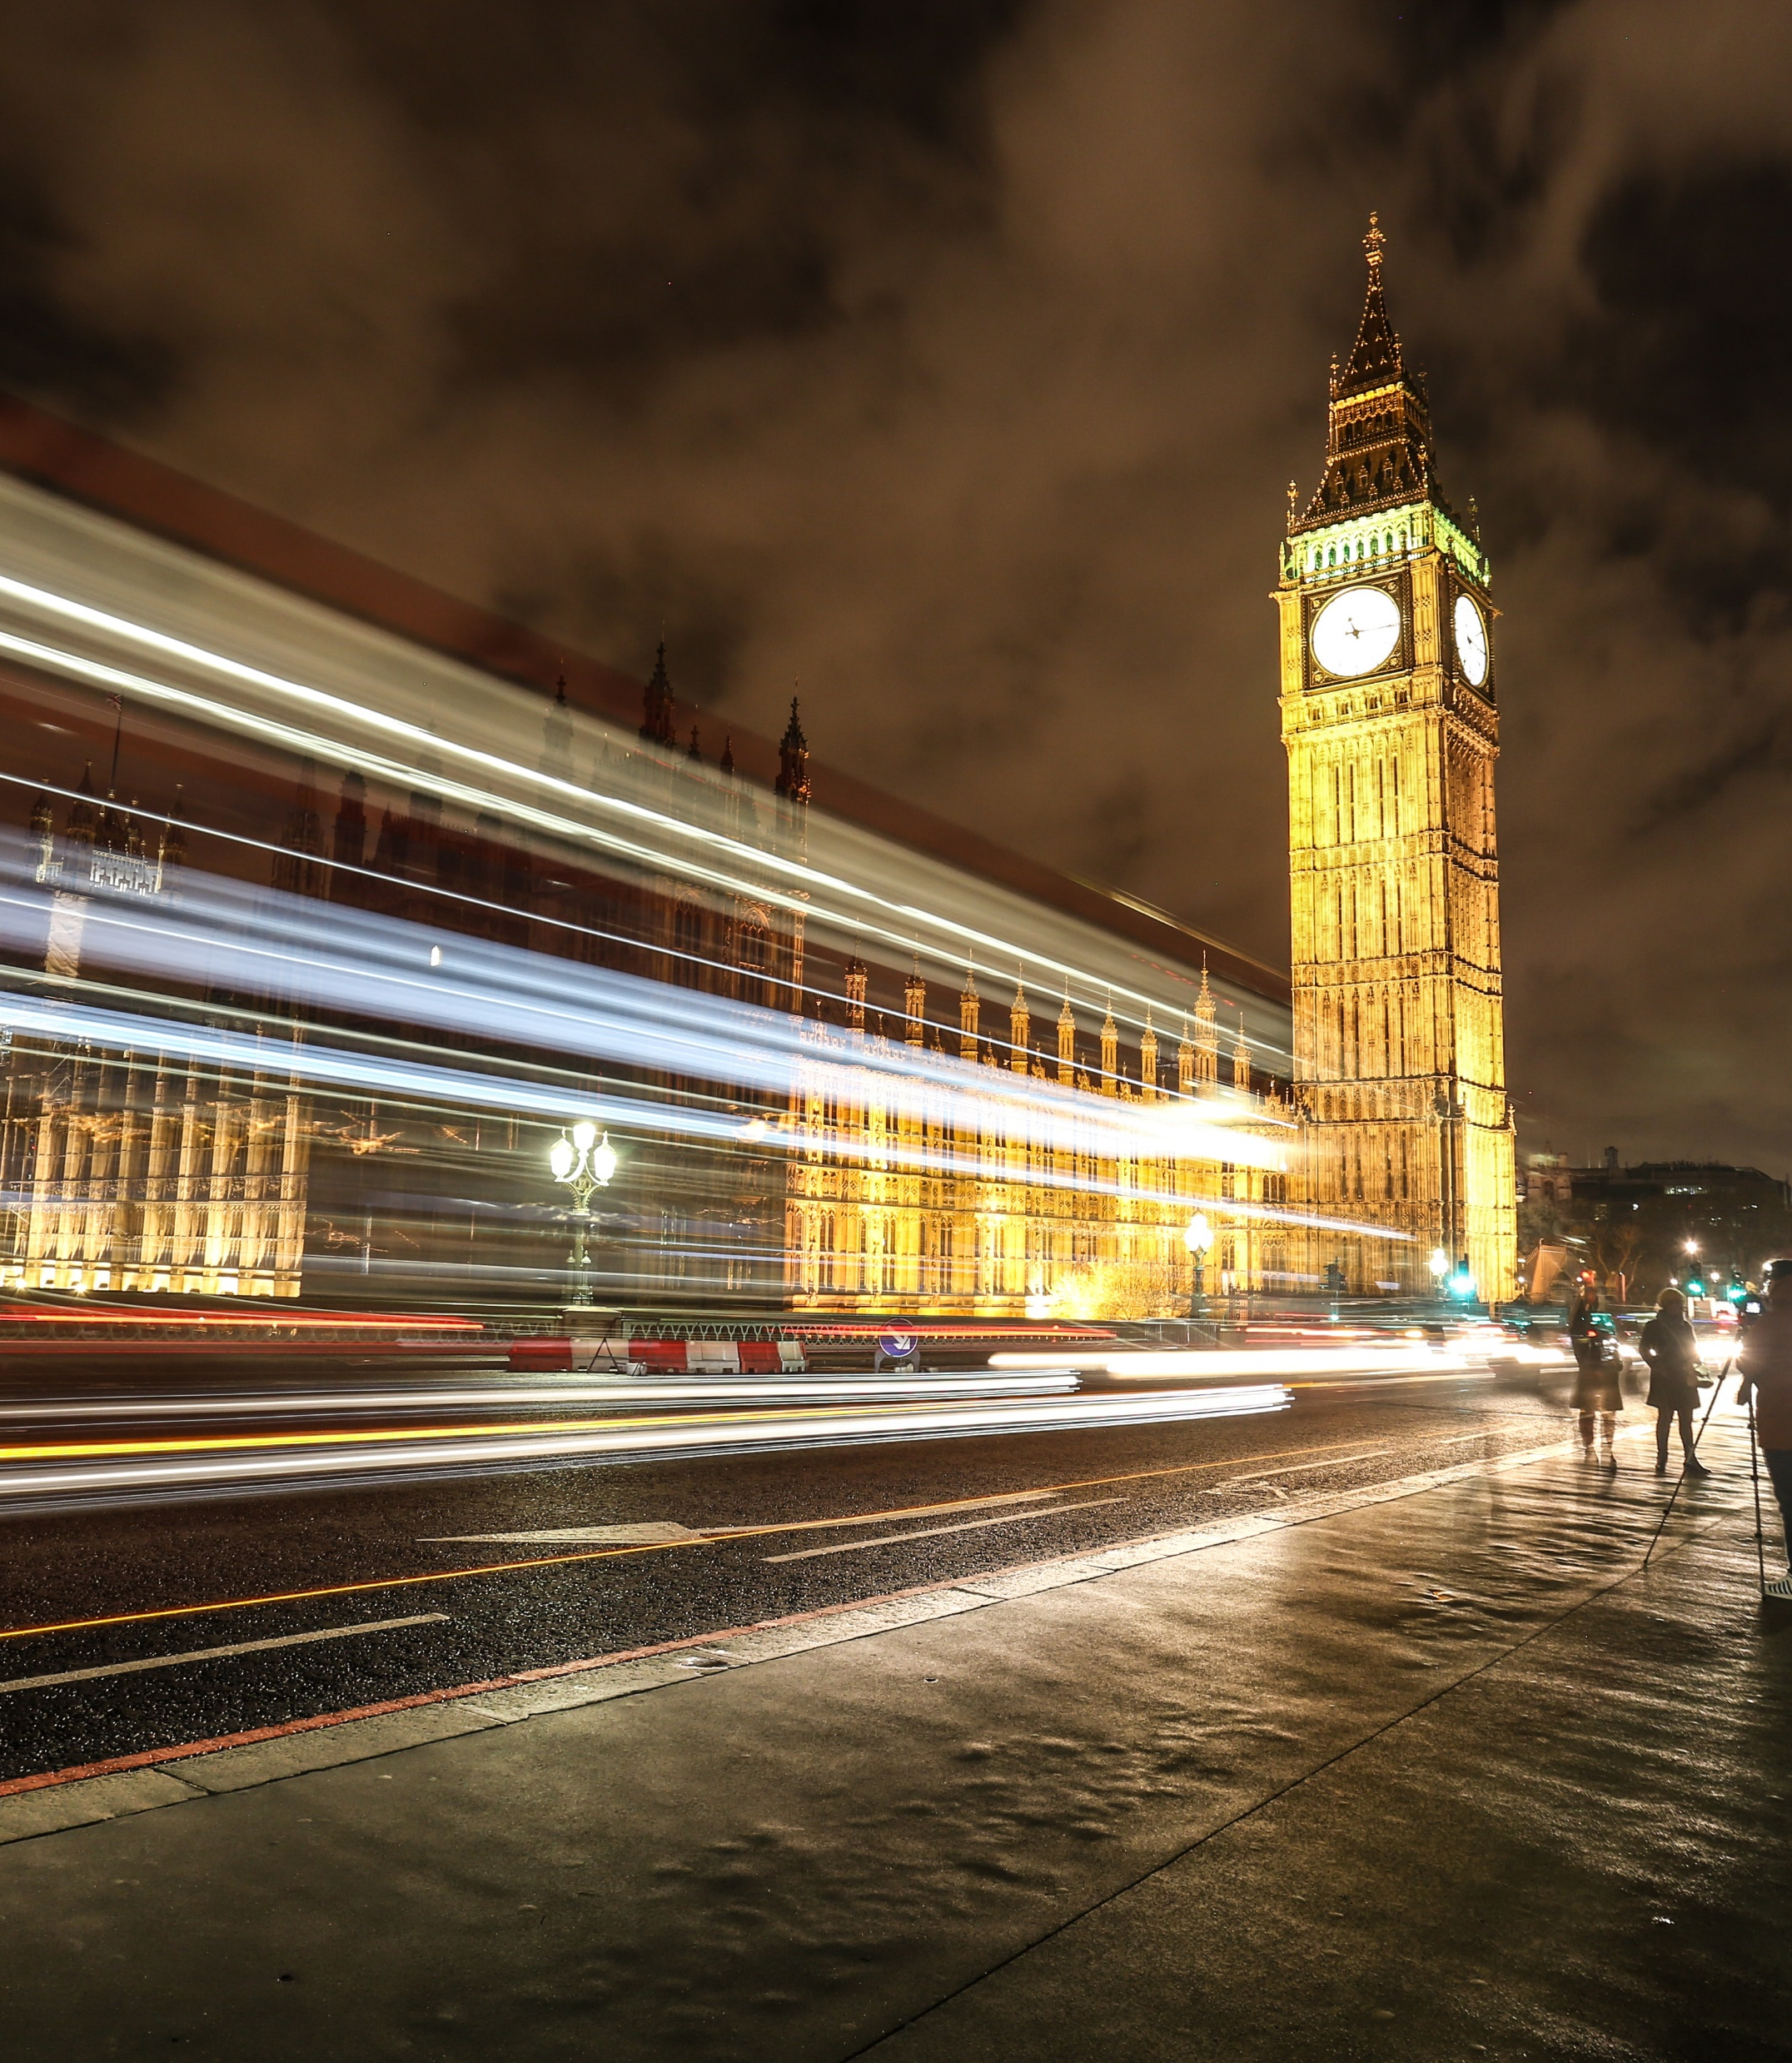
State actors
Home Office
Dept. Housing, Communities and Local Government
Dept. Digital, Culture, Media and Sport
NHS
Dept. of Education
Dept. of Work and Pensions
Treasury
FCDO
Ministry of Defence
Opposition parties

Slide 6

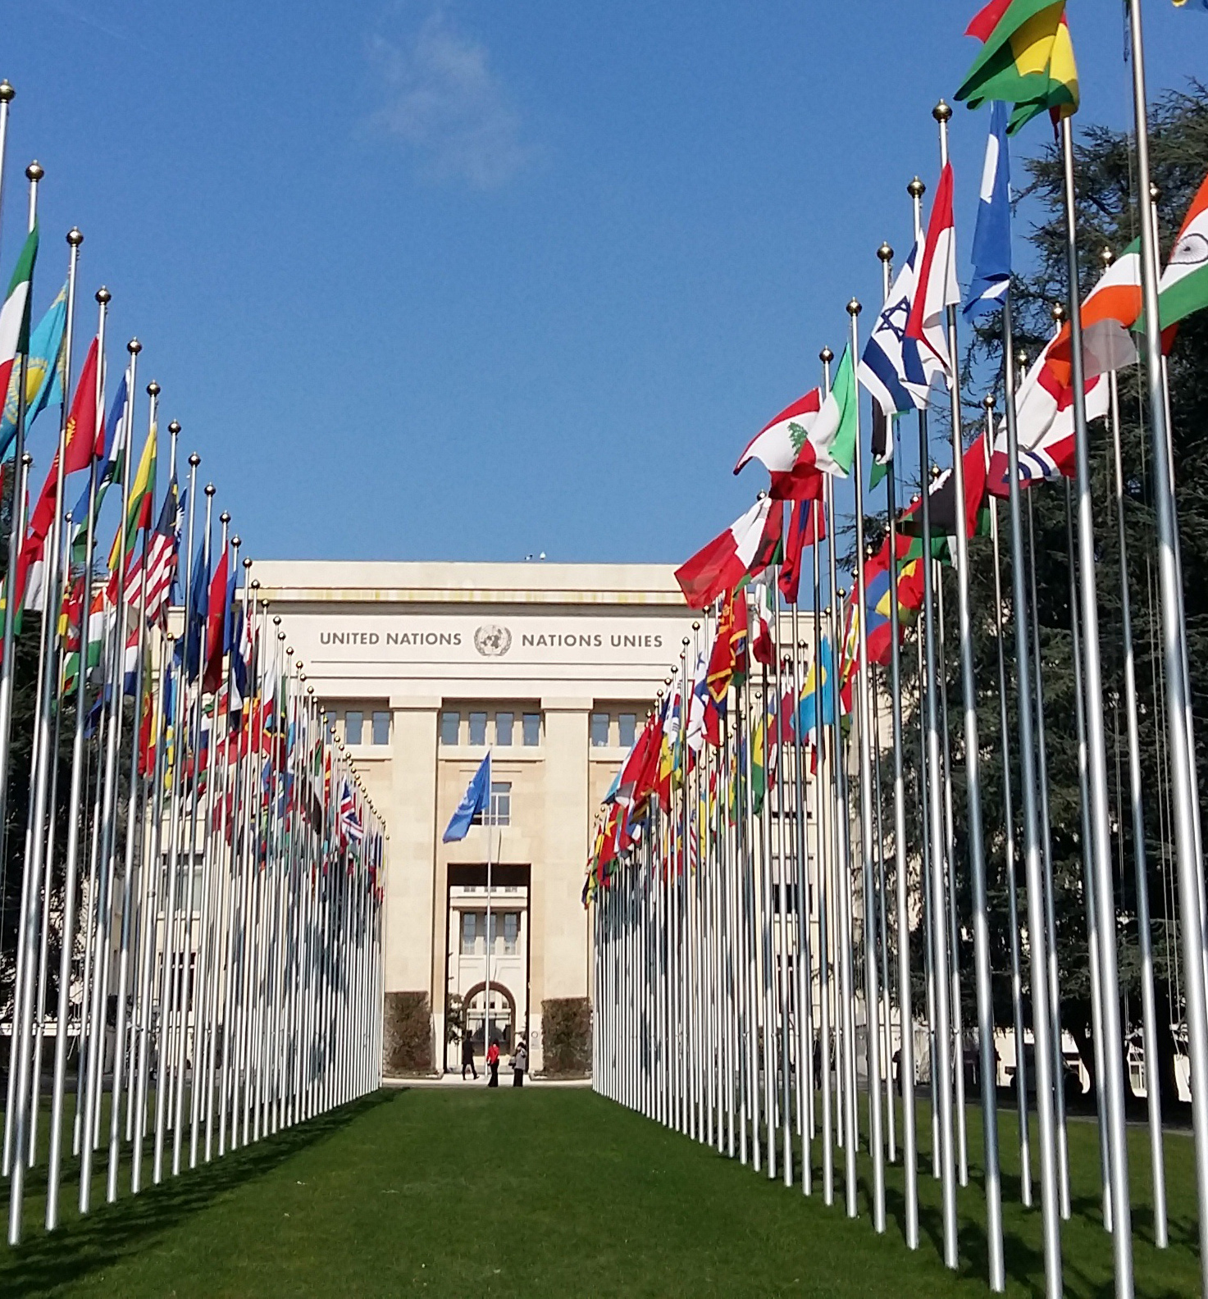
Inter-state actors
European Union
United Nations

Slide 7
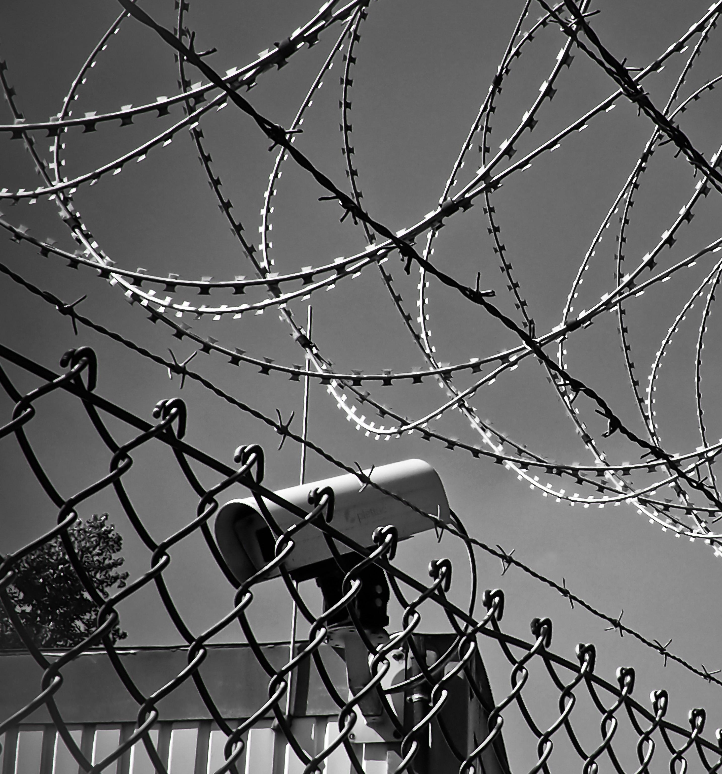
Economic Interests
Criminal networks and smaller scale crimes
Security industry
Arms industry
Refugee savings and earnings

Slide 8
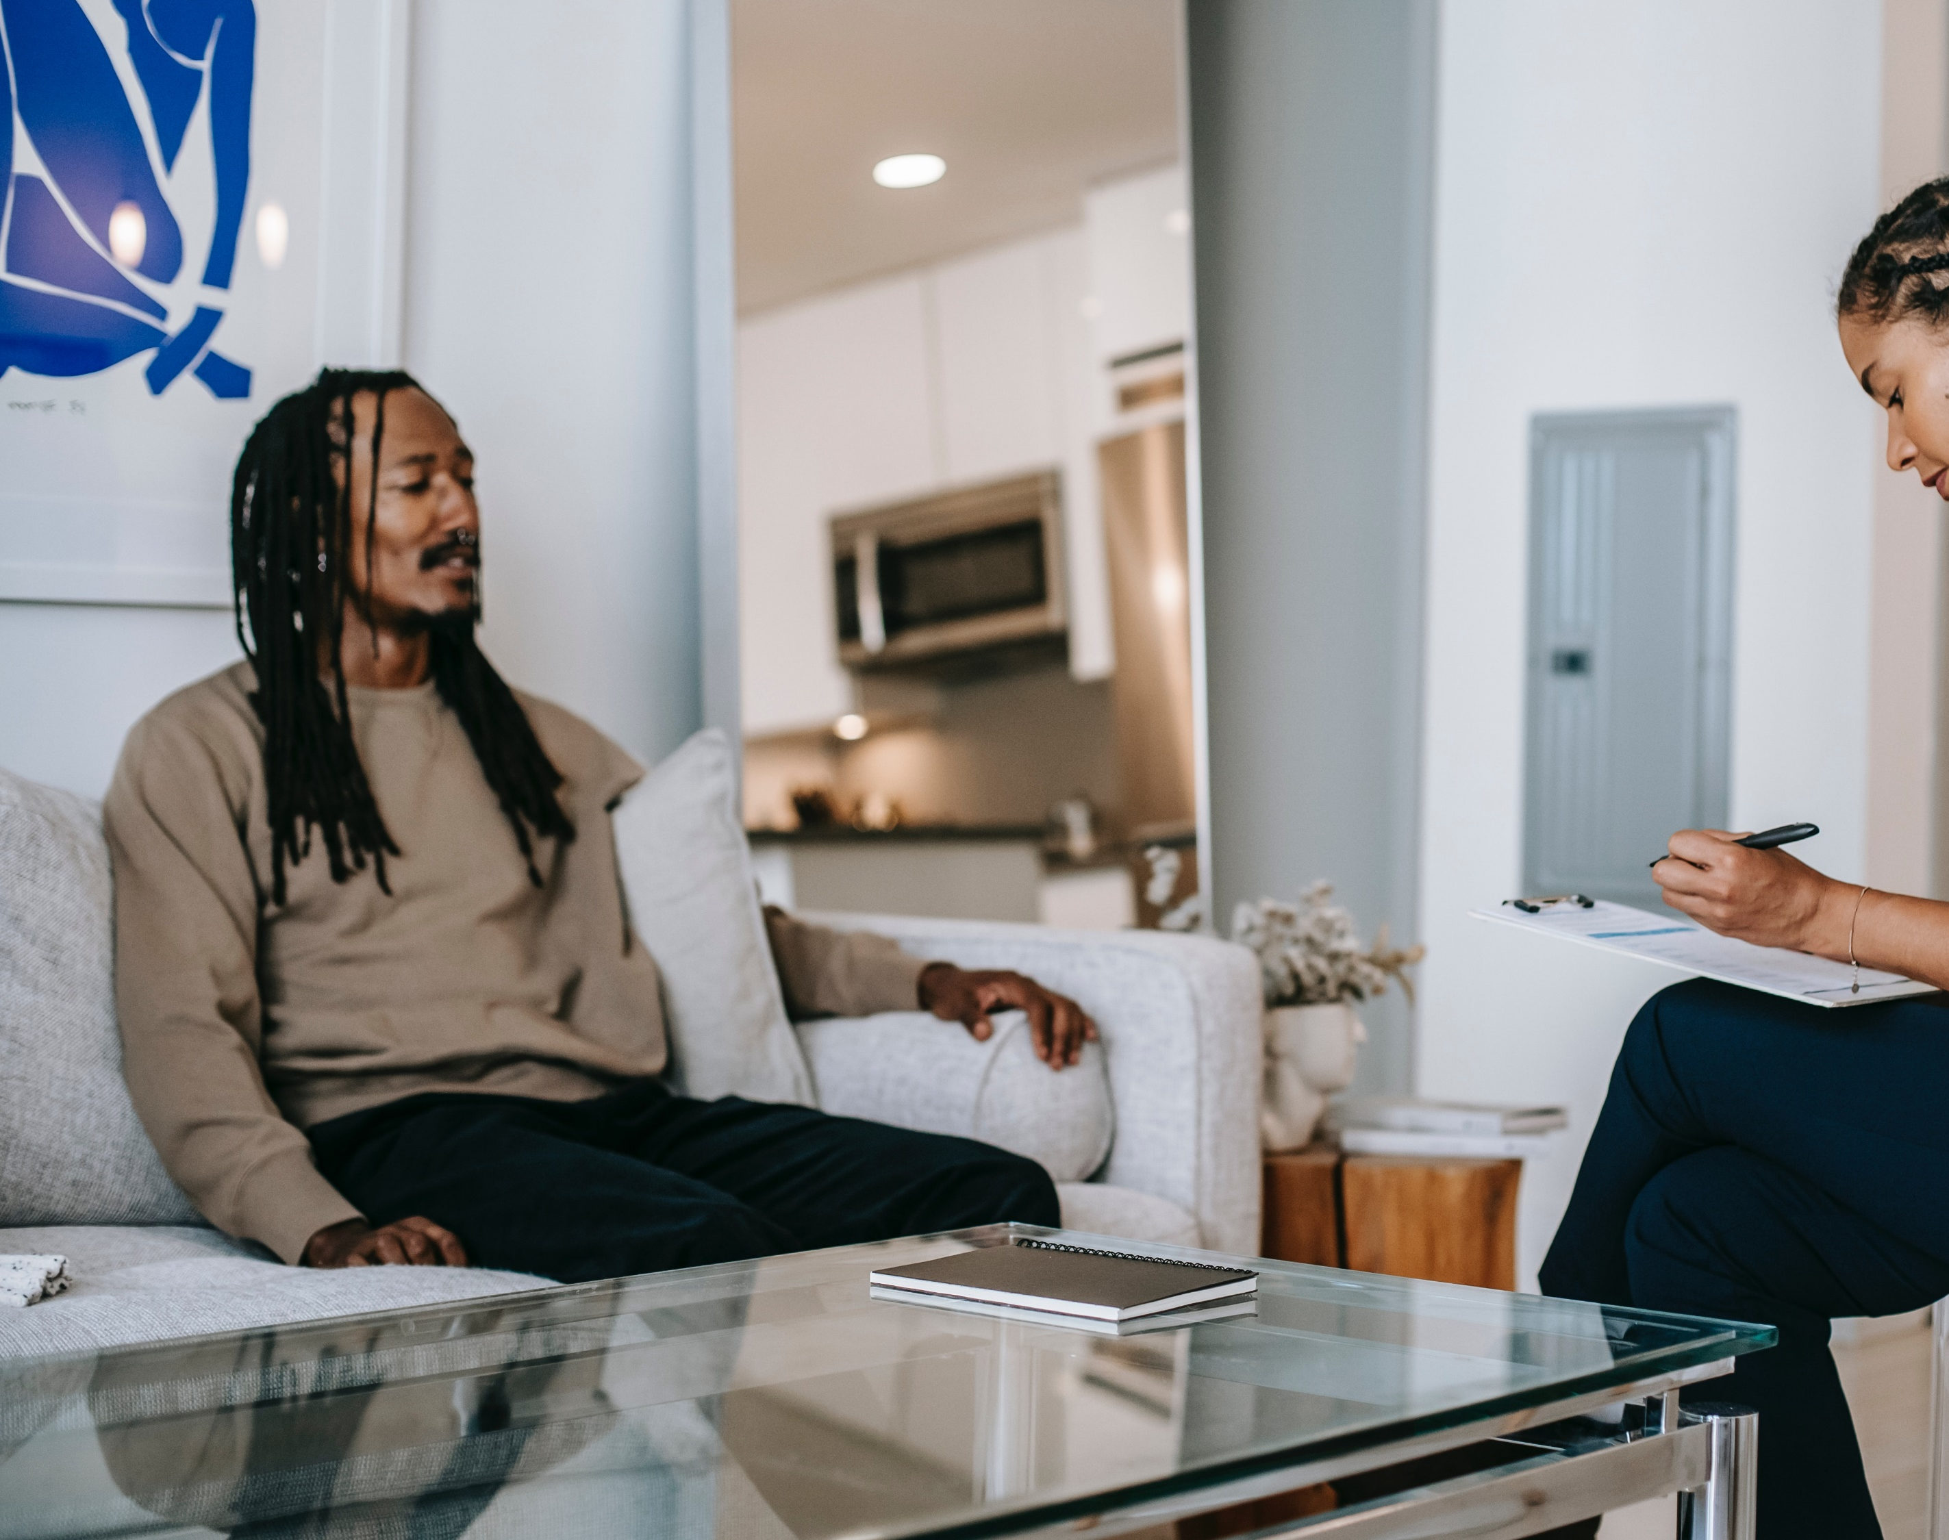
Civil Society
The legal profession;
Labour representation;
Media;
Citizens’ organisations;
International non-governmental agencies;
Large domestic NGOs;
Campaigning and advocacy organisations;
Community organisations; and
Faith institutions and communities.

Slide 9
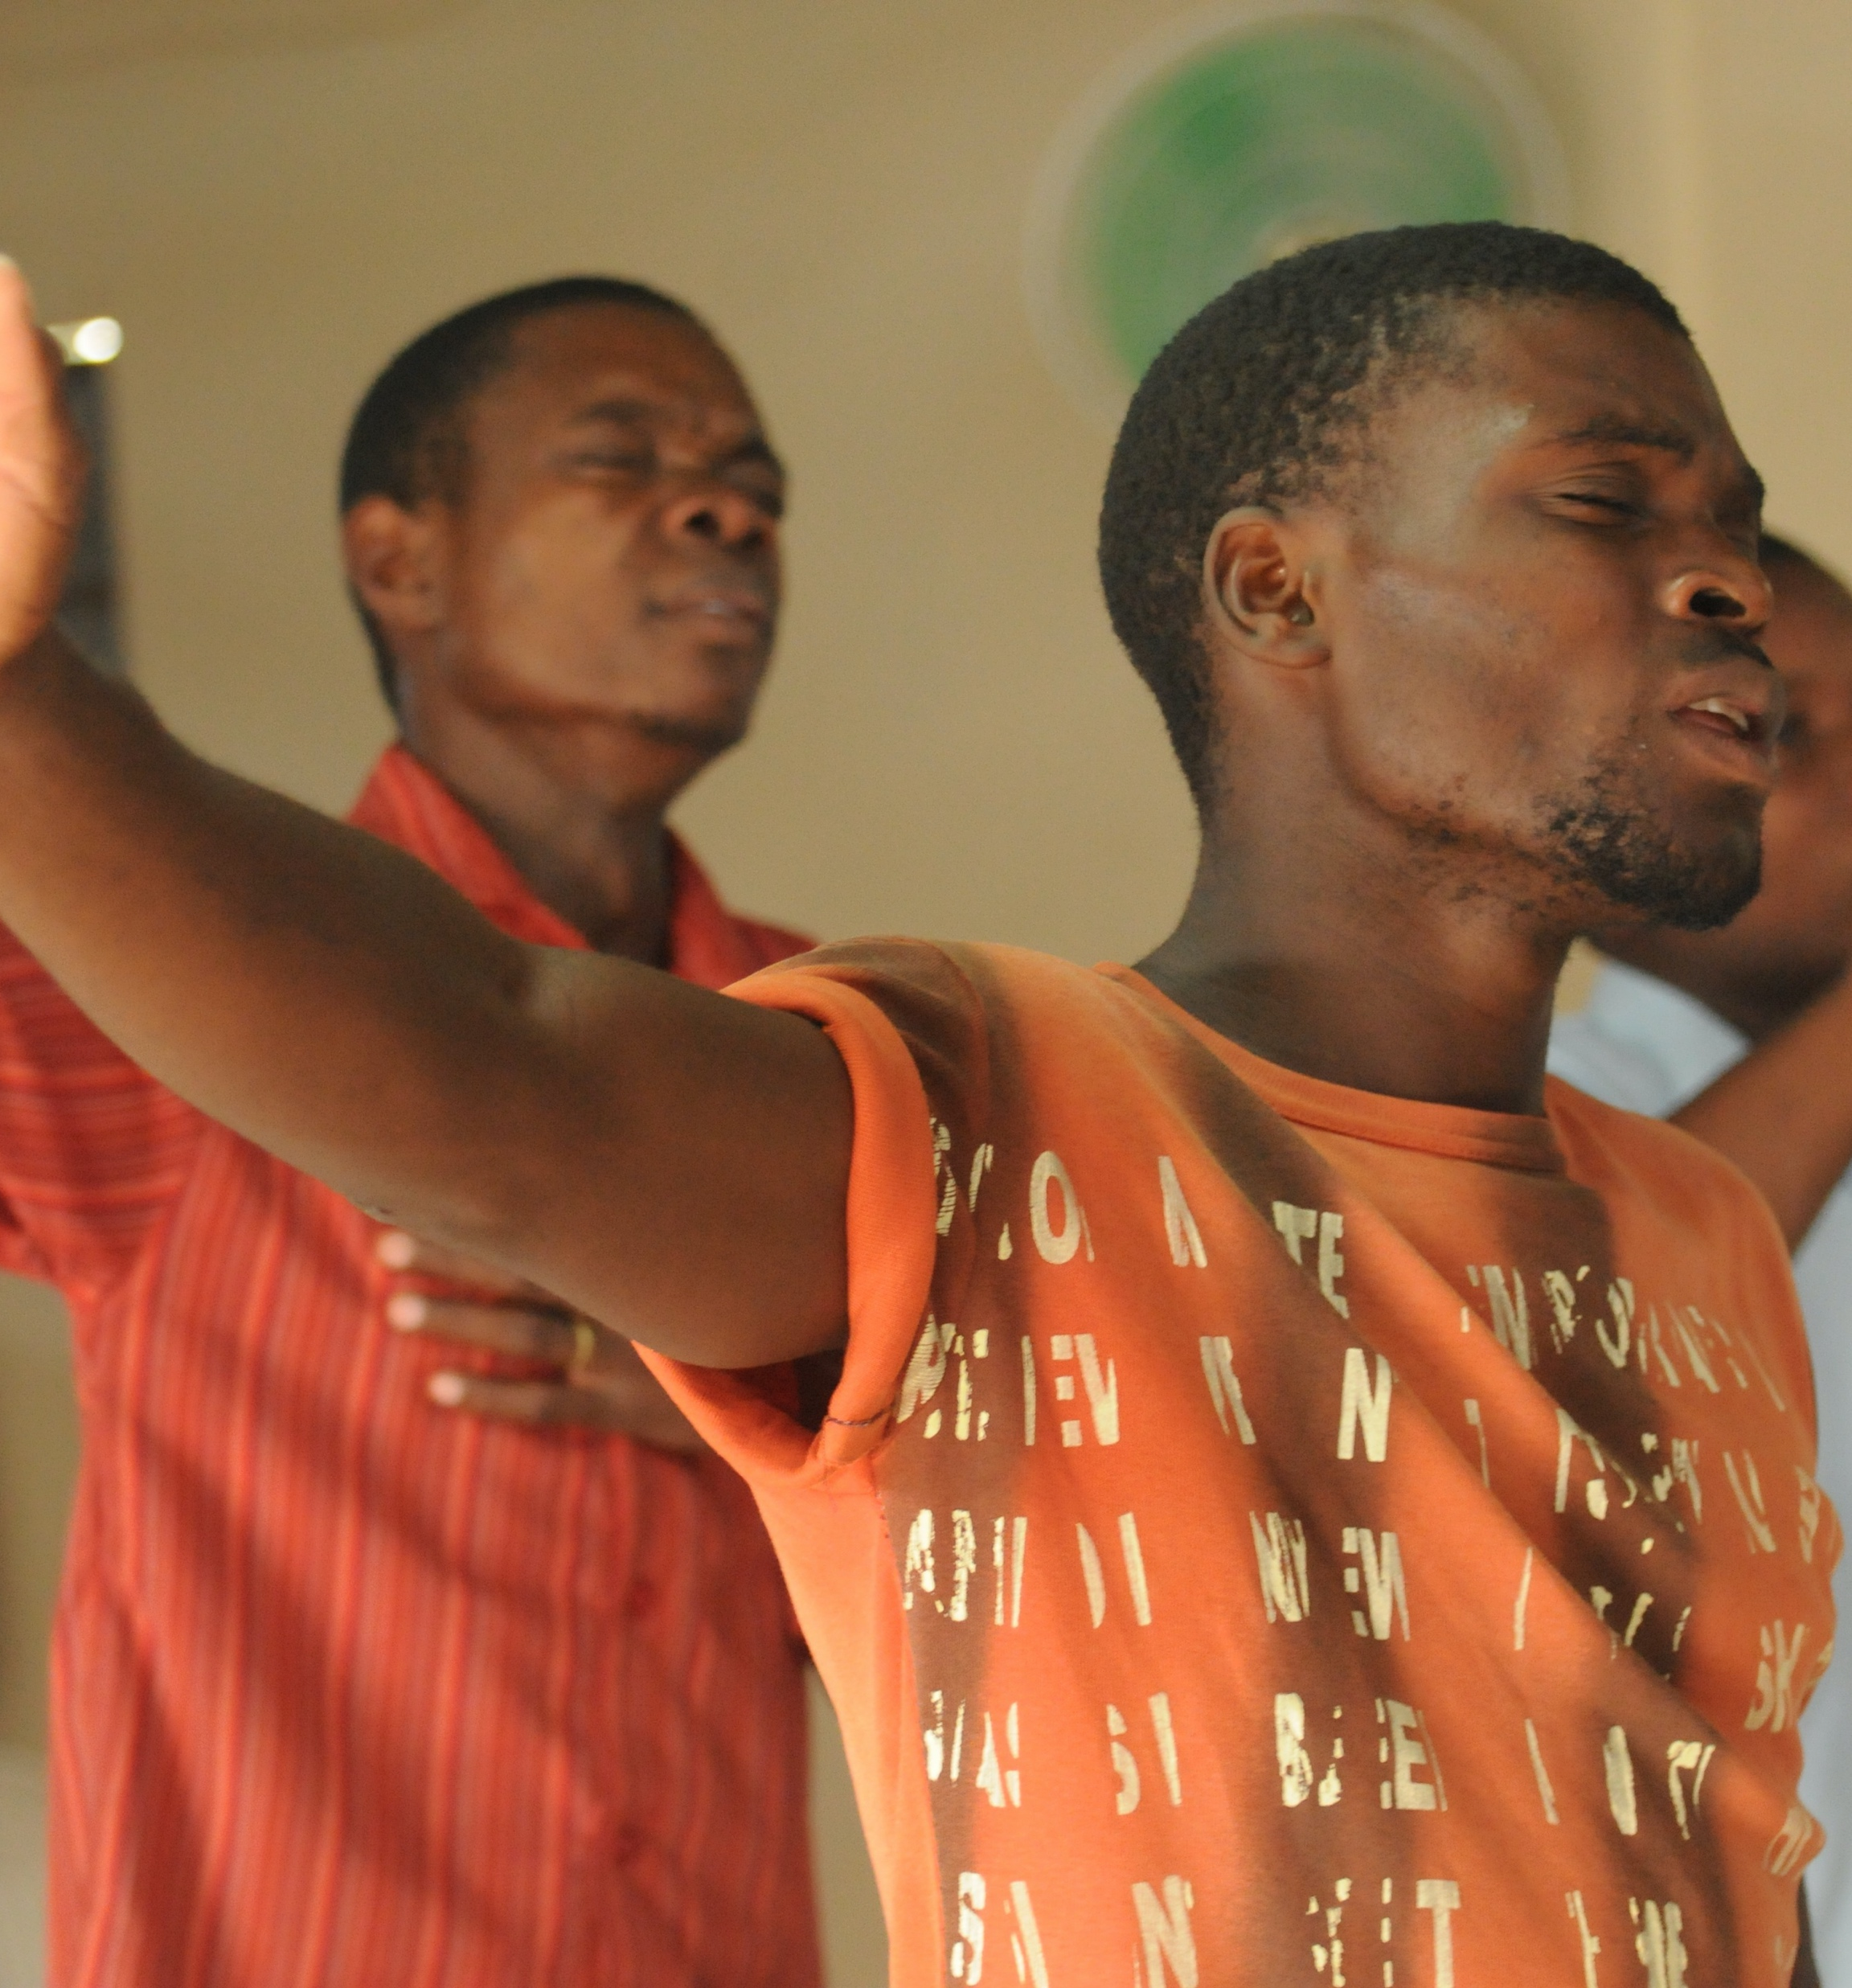
People who claim their asylum rights
Choices in departure, transit and arrival
Community organisations
Faith communities
Cultural and linguistic groupings
Advocacy and campaigning for human rights in country of origin

Slide 10
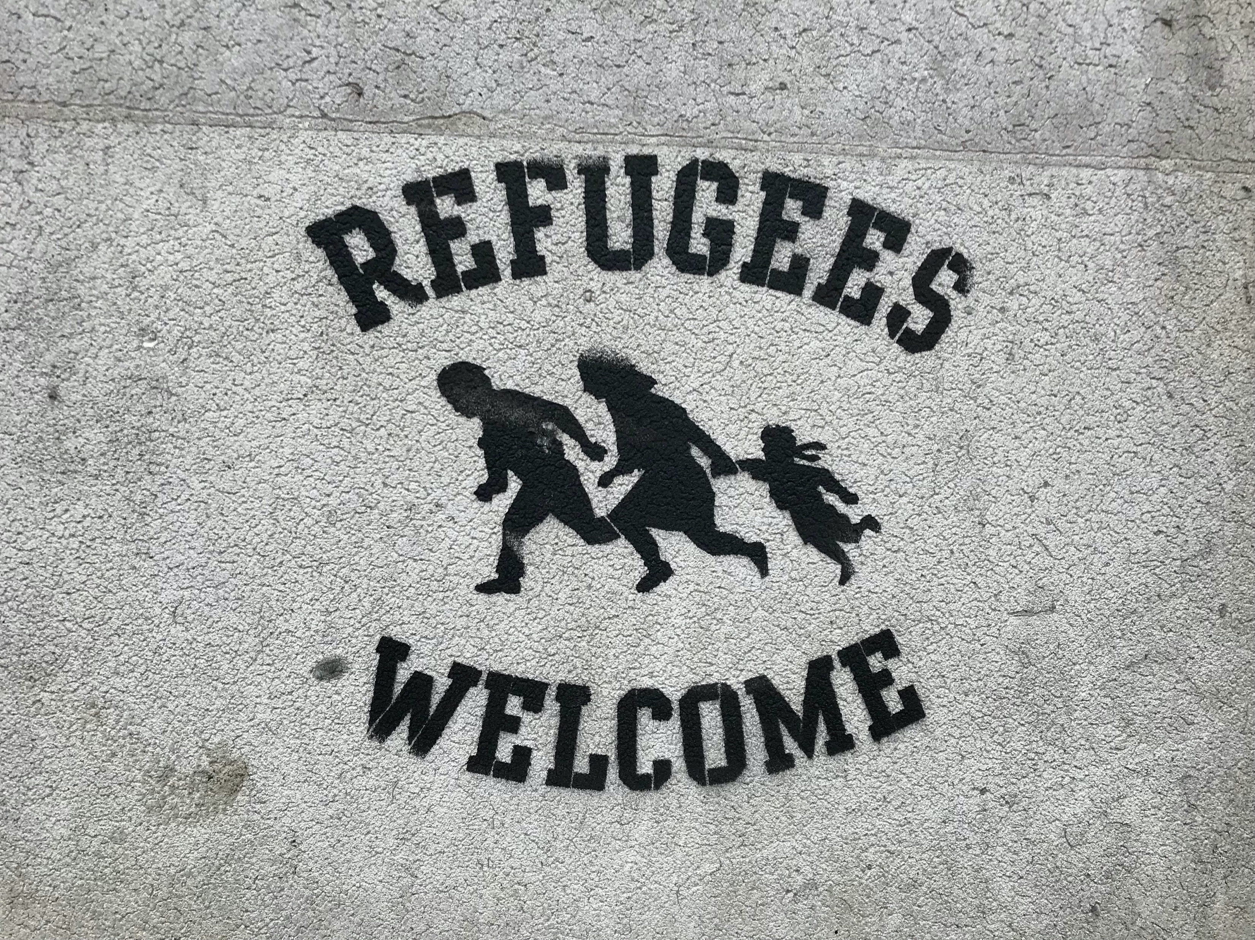
Christians within a movement for change
Photo: MattFromLondon

Slide 11
Historical
Asylum is a faith issue
Colonial legacy and reparations
Understanding root causes

Slide 12

Political
Borders and nation states
Sovereignty and cooperation
Public opinion
Conflict resolution
Prophetic witness

Slide 13

Economic
Economic scarring of conflicted countries
Reallocation of resources
Diversification of arms industry
Valorise the refugee economy

Slide 14
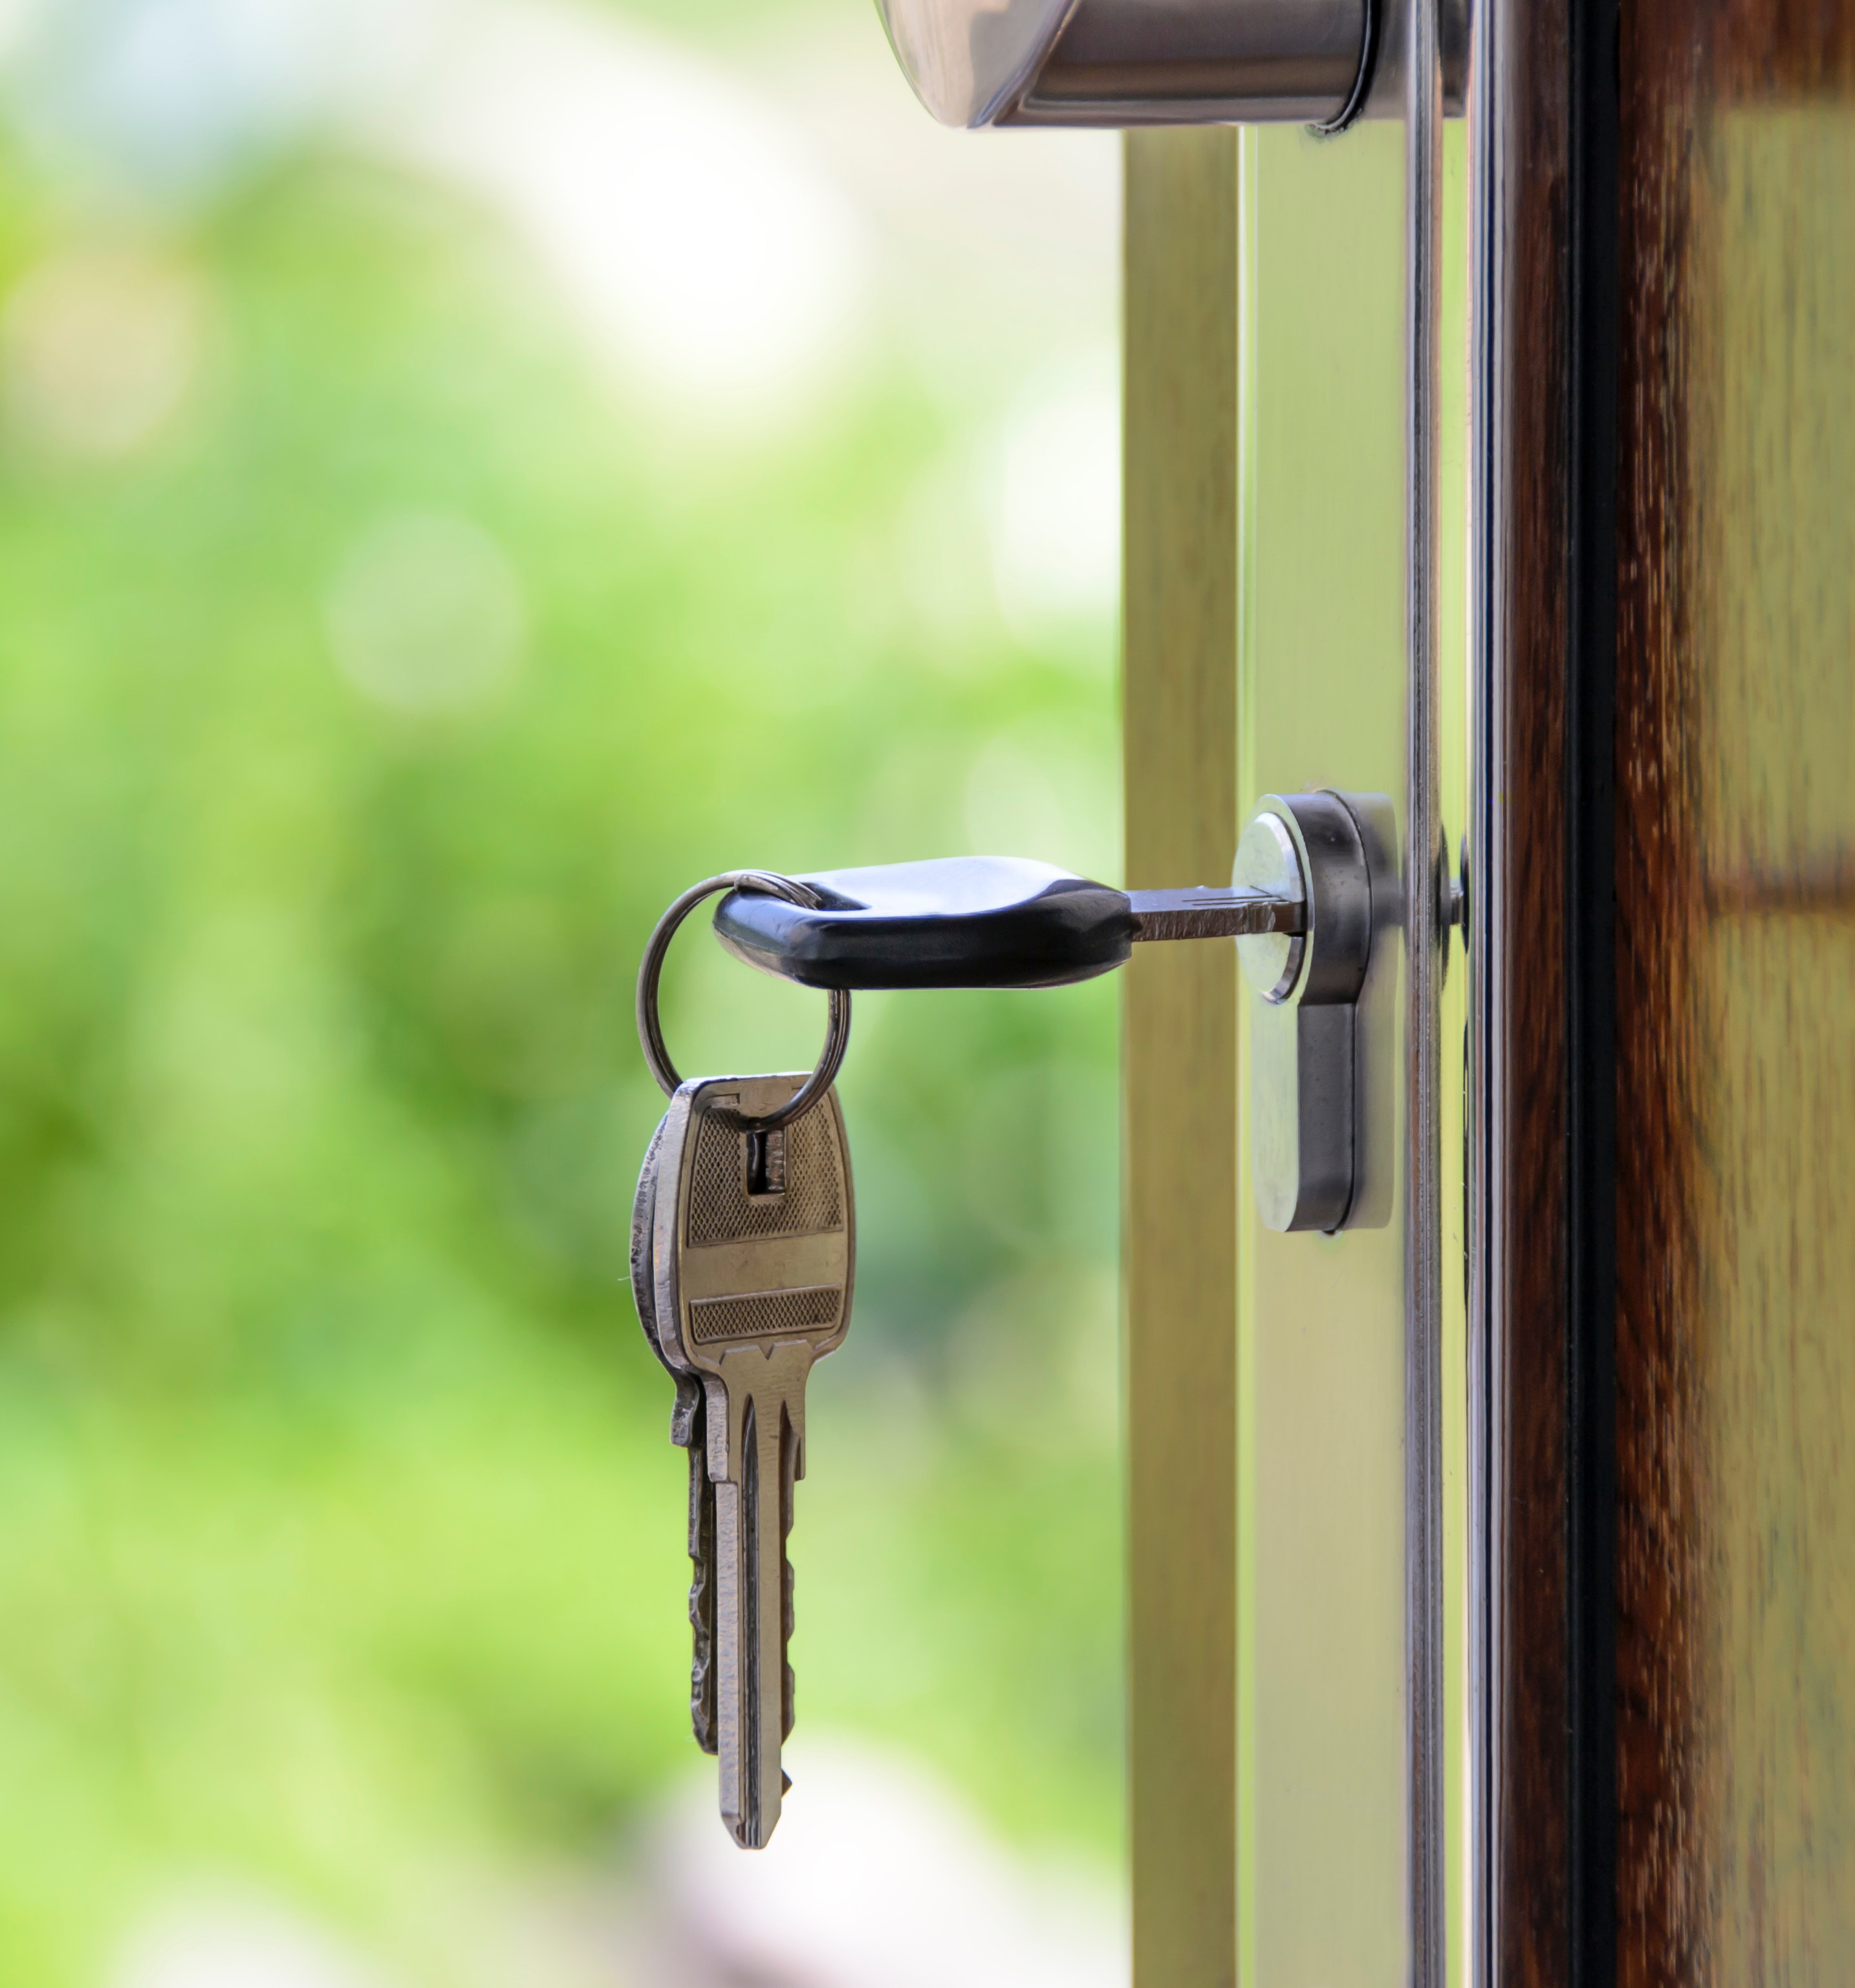
Social protection - pathways to independence
Right to work and income
Decent accommodation
Health – trauma recovery and physical
Child refugees
Gender-based violence
LGBTQ+
Pathways

Slide 15
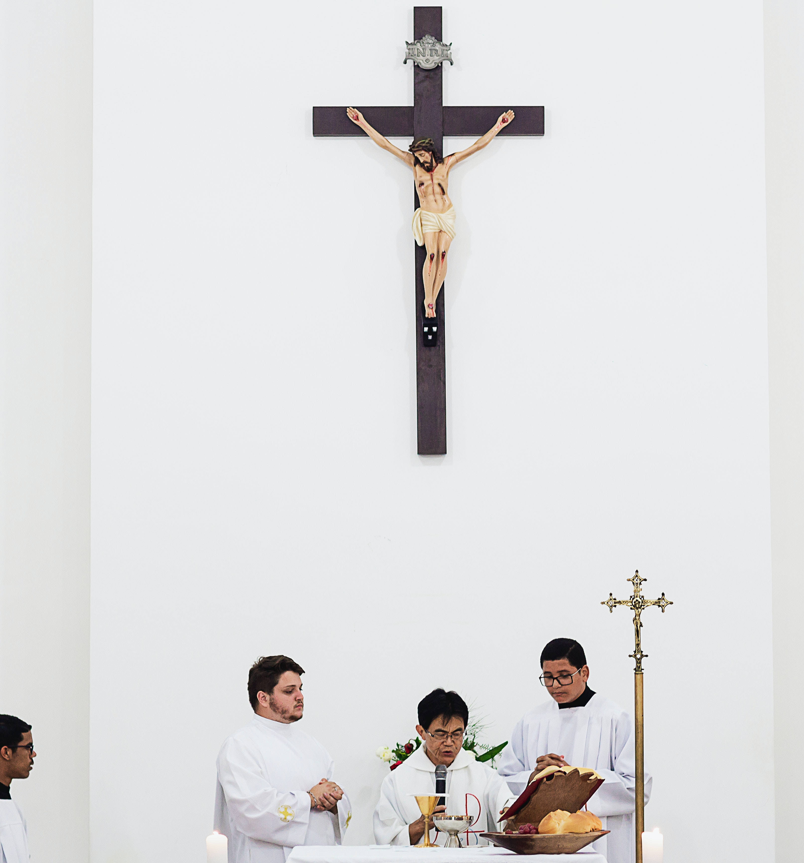
Faith and culture
Faith and identity
Language
Social and bridging capital
Diaspora and social media

Slide 16
Questions
What is our contribution as Christians to the transformation of the asylum space?
How do we engage with the key actors:
State and inter-state agencies
Economic interests
Civil society
People who claim their asylum rights
1. Understanding the causes of conflict and conflict resolution
2. Routes out of danger and immediate safety and protection
3. Arrival and reception
4. Advocacy and representation in legal processes
5. Media and changing the narrative
6. Political advocacy
7. Creating new communities
8. Faith journeys – ensuring space to be people of faith in exile and the deepening of all our faith

Slide 17
Out of sight not out of mind – understanding the conflict in Tigray
Union Chapel Webinar
Wednesday May 5th at 7.00
Martin Plaut
Dr Berhanu Kassayie
Mebrat Deres
Dr Moses Waldeselassie

