Slide 1
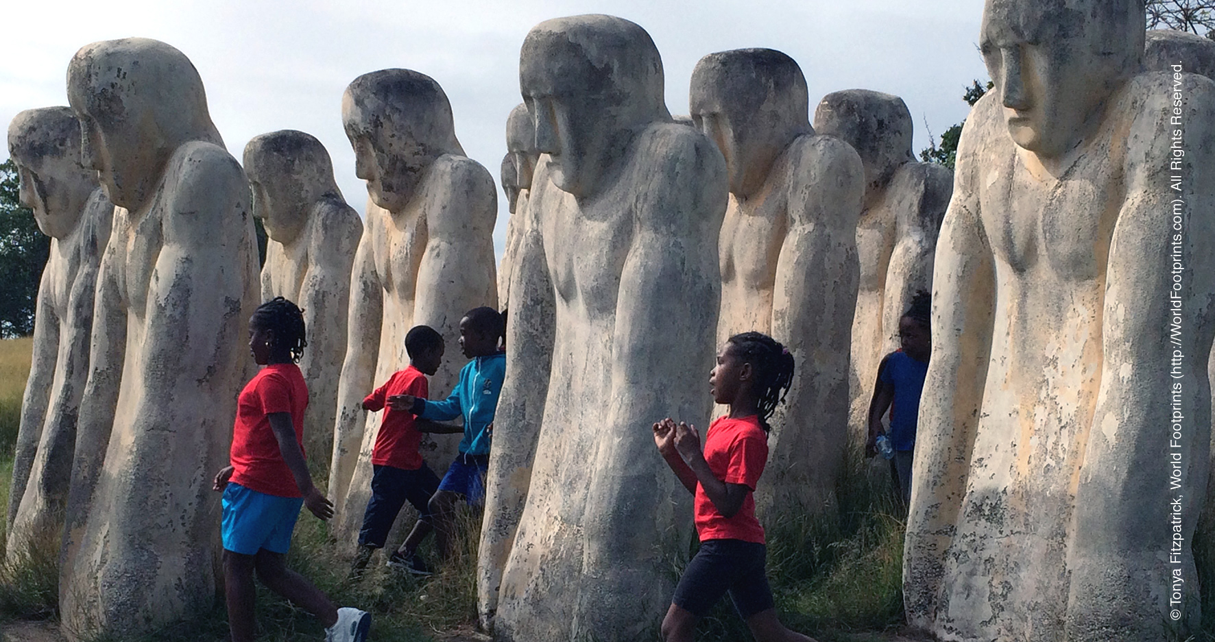

Week of Prayer for Christian Unity 2018
‘THAT ALL MAY BE FREE’
Your right hand, O LORD, glorious in power (Ex 15:6)

Slide 2
Gathering Holy Spirit Reconciliation Proclamation Commitment Prayer Blessing
GATHERING

Slide 3
Gathering Holy Spirit Reconciliation Proclamation Commitment Prayer Blessing
Processional hymn
Stand

Slide 4
Gathering Holy Spirit Reconciliation Proclamation Commitment Prayer Blessing
WELCOME

Slide 5
Gathering Holy Spirit Reconciliation Proclamation Commitment Prayer Blessing
Words of Welcome
The grace of our Lord Jesus Christ,
the love of God,
and the fellowship of the Holy Spirit be with you all.
And also with you.

Slide 6
Gathering Holy Spirit Reconciliation Proclamation Commitment Prayer Blessing
INVOCATION OF THE HOLY SPIRIT

Slide 7
Gathering Holy Spirit Reconciliation Proclamation Commitment Prayer Blessing
Unite your servants in the bond of unity.
Come, Holy Spirit!
Teach us to pray.
Come, Holy Spirit!

Slide 8
Gathering Holy Spirit Reconciliation Proclamation Commitment Prayer Blessing
Liberate us from the slavery of sin.
Come, Holy Spirit!
Help us in our weakness.
Come, Holy Spirit!

Slide 9
Gathering Holy Spirit Reconciliation Proclamation Commitment Prayer Blessing
Restore us as your children.
Come, Holy Spirit!

Slide 10
Gathering Holy Spirit Reconciliation Proclamation Commitment Prayer Blessing
Song of Praise

Slide 11
Gathering Holy Spirit Reconciliation Proclamation Commitment Prayer Blessing
Prayers of Reconciliation

Slide 12
Gathering Holy Spirit Reconciliation Proclamation Commitment Prayer Blessing
Forgive us when we fall into old habits of sin that undermine the dignity of others.
Kyrie eleison.
Kyrie eleison.

Slide 13
Gathering Holy Spirit Reconciliation Proclamation Commitment Prayer Blessing
Forgive us when our choices perpetuate enslavement and poverty.
Kyrie eleison.
Kyrie eleison.

Slide 14
Gathering Holy Spirit Reconciliation Proclamation Commitment Prayer Blessing
Forgive us when fear and suspicion separate us from each other and place limits on hope and healing.
Kyrie eleison.
Kyrie eleison.

Slide 15
The Word of God
Old Testament Reading
Exodus 15:1-17
Gathering Holy Spirit Reconciliation Proclamation Commitment Prayer Blessing

Slide 16
Then Moses and the Israelites sang this song to the Lord:
‘I will sing to the Lord, for he has triumphed gloriously; horse and rider he has thrown into the sea. The Lord is my strength and my might, and he has become my salvation; this is my God, and I will praise him, my father’s God, and I will exalt him. The Lord is a warrior; the Lord is his name.

Slide 17
‘Pharaoh’s chariots and his army he cast into the sea; his picked officers were sunk in the Red Sea. The floods covered them; they went down into the depths like a stone Your right hand, O Lord, glorious in power— your right hand, O Lord, shattered the enemy. In the greatness of your majesty you overthrew your adversaries; you sent out your fury, it consumed them like stubble.

Slide 18
At the blast of your nostrils the waters piled up, the floods stood up in a heap; the deeps congealed in the heart of the sea. The enemy said, “I will pursue, I will overtake, I will divide the spoil, my desire shall have its fill of them. I will draw my sword, my hand shall destroy them.” You blew with your wind, the sea covered them; they sank like lead in the mighty waters.

Slide 19
‘Who is like you, O Lord, among the gods? Who is like you, majestic in holiness, awesome in splendour, doing wonders? You stretched out your right hand, the earth swallowed them.
‘In your steadfast love you led the people whom you redeemed; you guided them by your strength to your holy abode.’

Slide 20
Gathering Holy Spirit Reconciliation Proclamation Commitment Prayer Blessing
Response:
Listen and you will be set free.
Thanks be to God.

Slide 21
The Word of God
From the Psalms
Psalm 118: 5-7, 10-24
Gathering Holy Spirit Reconciliation Proclamation Commitment Prayer Blessing

Slide 22
Out of my distress I called on the Lord;
the Lord answered me and set me in a broad place. With the Lord on my side I do not fear.
What can mortals do to me? The Lord is on my side to help me; I shall look in triumph on those who hate me.

Slide 23
Gathering Holy Spirit Reconciliation Proclamation Commitment Prayer Blessing
Response:
O give thanks to the Lord, for he is good;
his steadfast love endures for ever!

Slide 24
I was pushed hard, so that I was falling,
but the Lord helped me. The Lord is my strength and my might; he has become my salvation.
There are glad songs of victory in the tents of the righteous:

Slide 25
Response:
O give thanks to the Lord, for he is good;
his steadfast love endures for ever!
Gathering Holy Spirit Reconciliation Proclamation Commitment Prayer Blessing

Slide 26
The right hand of the Lord does valiantly;
the right hand of the Lord is exalted; the right hand of the Lord does valiantly.’ I shall not die, but I shall live, and recount the deeds of the Lord.

Slide 27
Response:
O give thanks to the Lord, for he is good;
his steadfast love endures for ever!
Gathering Holy Spirit Reconciliation Proclamation Commitment Prayer Blessing

Slide 28
Open to me the gates of righteousness,
that I may enter through them and give thanks to the Lord. This is the gate of the Lord; the righteous shall enter through it.

Slide 29
Response:
O give thanks to the Lord, for he is good;
his steadfast love endures for ever!
Gathering Holy Spirit Reconciliation Proclamation Commitment Prayer Blessing

Slide 30
I thank you that you have answered me and have become my salvation. This is the Lord’s doing;
it is marvellous in our eyes. This is the day that the Lord has made; let us rejoice and be glad in it.

Slide 31
Response:
O give thanks to the Lord, for he is good;
his steadfast love endures for ever!
Gathering Holy Spirit Reconciliation Proclamation Commitment Prayer Blessing

Slide 32
The Word of God
New Testament Reading
Romans 8:12-27
Gathering Holy Spirit Reconciliation Proclamation Commitment Prayer Blessing

Slide 33
So then, brothers and sisters, we are debtors, not to the flesh, to live according to the flesh— for if you live according to the flesh, you will die; but if by the Spirit you put to death the deeds of the body, you will live. For all who are led by the Spirit of God are children of God. For you did not receive a spirit of slavery to fall back into fear, but you have received a spirit of adoption.

Slide 34
When we cry, ‘Abba! Father!’ it is that very Spirit bearing witness with our spirit that we are children of God, and if children, then heirs, heirs of God and joint heirs with Christ—if, in fact, we suffer with him so that we may also be glorified with him.

Slide 35
I consider that the sufferings of this present time are not worth comparing with the glory about to be revealed to us. For the creation waits with eager longing for the revealing of the children of God; for the creation was subjected to futility, not of its own will but by the will of the one who subjected it, in hope that the creation itself will be set free from its bondage to decay and will obtain the freedom of the glory of the children of God.

Slide 36
We know that the whole creation has been groaning in labour pains until now; and not only the creation, but we ourselves, who have the first fruits of the Spirit, groan inwardly while we wait for adoption, the redemption of our bodies. For in hope we were saved. Now hope that is seen is not hope. For who hopes for what is seen? But if we hope for what we do not see, we wait for it with patience.

Slide 37
Likewise the Spirit helps us in our weakness; for we do not know how to pray as we ought, but that very Spirit intercedes with sighs too deep for words. And God, who searches the heart, knows what is the mind of the Spirit, because the Spirit intercedes for the saints according to the will of God.

Slide 38
Response:
Listen and you will be set free.
Thanks be to God.
Gathering Holy Spirit Reconciliation Proclamation Commitment Prayer Blessing

Slide 39
Gathering Holy Spirit Reconciliation Proclamation Commitment Prayer Blessing
Hymn sung or music played

Slide 40
The Word of God
Gospel Reading
Mark 5:21-43
Gathering Holy Spirit Reconciliation Proclamation Commitment Prayer Blessing

Slide 41
When Jesus had crossed again in the boat to the other side, a great crowd gathered round him; and he was by the lake. Then one of the leaders of the synagogue named Jairus came and, when he saw him, fell at his feet and begged him repeatedly, ‘My little daughter is at the point of death. Come and lay your hands on her, so that she may be made well, and live.’ So he went with him.

Slide 42
And a large crowd followed him and pressed in on him. Now there was a woman who had been suffering from haemorrhages for twelve years. She had endured much under many physicians, and had spent all that she had; and she was no better, but rather grew worse. She had heard about Jesus, and came up behind him in the crowd and touched his cloak, for she said, ‘If I but touch his clothes, I will be made well.’

Slide 43
Immediately her haemorrhage stopped; and she felt in her body that she was healed of her disease. Immediately aware that power had gone forth from him, Jesus turned about in the crowd and said, ‘Who touched my clothes?’ And his disciples said to him, ‘You see the crowd pressing in on you; how can you say, “Who touched me?”’

Slide 44
He looked all round to see who had done it. But the woman, knowing what had happened to her, came in fear and trembling, fell down before him, and told him the whole truth. He said to her, ‘Daughter, your faith has made you well; go in peace, and be healed of your disease.’

Slide 45
While he was still speaking, some people came from the leader’s house to say, ‘Your daughter is dead. Why trouble the teacher any further?’ But overhearing what they said, Jesus said to the leader of the synagogue, ‘Do not fear, only believe.’ He allowed no one to follow him except Peter, James, and John, the brother of James.

Slide 46
When they came to the house of the leader of the synagogue, he saw a commotion, people weeping and wailing loudly. When he had entered, he said to them, ‘Why do you make a commotion and weep? The child is not dead but sleeping.’ And they laughed at him. Then he put them all outside, and took the child’s father and mother and those who were with him, and went in where the child was.

Slide 47
He took her by the hand and said to her, ‘Talitha cum’, which means, ‘Little girl, get up!’ And immediately the girl got up and began to walk about (she was twelve years of age). At this they were overcome with amazement. He strictly ordered them that no one should know this, and told them to give her something to eat.

Slide 48
Response:
Listen and you will be set free.
Thanks be to God.
Gathering Holy Spirit Reconciliation Proclamation Commitment Prayer Blessing

Slide 49
Gathering Holy Spirit Reconciliation Proclamation Commitment Prayer Blessing
Homily / Sermon / Reflection

Slide 50
Gathering Holy Spirit Reconciliation Proclamation Commitment Prayer Blessing
The Apostles’ Creed

Slide 51
I BELIEVE in God, the Father almighty,
creator of heaven and earth.
I believe in Jesus Christ, his only Son, our Lord.
He was conceived by the power of the Holy Spirit
and born of the Virgin Mary.
He suffered under Pontius Pilate,
was crucified, died, and was buried.

Slide 52
He descended to the dead.
On the third day he rose again.
He ascended into heaven,
and is seated at the right hand of the Father.
He will come again to judge the living and the dead.

Slide 53
I believe in the Holy Spirit,
the holy catholic Church,
the communion of saints,
the forgiveness of sins,
  the resurrection of the body,
and the life everlasting.
Amen.

Slide 54
Gathering Holy Spirit Reconciliation Proclamation Commitment Prayer Blessing
Let us sing
‘The right hand of God is writing in our land’

Slide 55
The right hand of God
is writing in our land,
Writing with power and with love;
Our conflicts and our fears,
Our triumphs and our tears,
Are recorded by the right hand of God.

Slide 56
The right hand of God
is striking in our land,
Striking out at envy, hate and greed;
Our selfishness and lust,
Our pride and deeds unjust,
Are destroyed by the right hand of God.

Slide 57
The right hand of God
is lifting in our land,
Lifting the fallen one by one;
Each one is known by name,
And rescued now from shame,
By the lifting of the right hand of God.

Slide 58
The right hand of God
is healing in our land,
Healing broken bodies, minds and souls;
So wondrous is its touch,
With love that means so much,
When we’re healed by the right hand of God.

Slide 59
Gathering Holy Spirit Reconciliation Proclamation Commitment Prayer Blessing
Let us pray…

Slide 60
God of the Exodus, you led your people through the Red Sea from slavery into freedom. Free us from all forms of slavery and everything that obscures human dignity.
Lead us by your hand, that we may live.

Slide 61
God of abundance, you provide for all our needs. Help us to rise above selfishness and greed and give us the courage to be agents of justice in the world.
Lead us by your hand, that we may live.

Slide 62
God of love, you created us in your image and have redeemed us in Christ. Empower us to love our neighbour and to welcome the stranger.
Lead us by your hand, that we may live.

Slide 63
God of the covenant you remain faithful to us even when we have wandered into violence. Put a new spirit and a new heart within us that we may instead be servants of your peace.
Lead us by your hand, that we may live.

Slide 64
God of glory, in Jesus you chose to humble yourself and become part of our story. You made your home with a human family, and have adopted us as your children. Help us to remain faithful to our families and communities, and make us one in Christ.
Lead us by your hand, that we may live.

Slide 65
God of the Trinity, you make us one with you and each other. Free us from the self-centredness, arrogance and fear that hinders the full visible unity of your Church.
Lead us by your hand, that we may live.

Slide 66
Gathering Holy Spirit Reconciliation Proclamation Commitment Prayer Blessing
The Lord’s Prayer…

Slide 67
Gathering Holy Spirit Reconciliation Proclamation Commitment Prayer Blessing
A Song of Unity

Slide 68
Gathering Holy Spirit Reconciliation Proclamation Commitment Prayer Blessing
The Sign of Peace…

Slide 69
Gathering Holy Spirit Reconciliation Proclamation Commitment Prayer Blessing
The Blessing

Slide 70
The Spirit of the Lord is upon us,
because the Lord has anointed us
to bring good news to the poor.
to proclaim release to the captives
and recovery of sight to the blind,
to let the oppressed go free,
to proclaim the year of the Lord’s favour.
Amen! Alleluia!
Luke 4: 18-19 (NRSV)

Slide 71
Gathering Holy Spirit Reconciliation Proclamation Commitment Prayer Blessing
Closing Song
New Revised Standard Version Bible: Anglicized Edition, copyright © 1989, 1995 National Council of the Churches of Christ in the United States of America. Used by permission. All rights reserved worldwide.
Photo: Flickr / Scott Robinson

