Slide 1
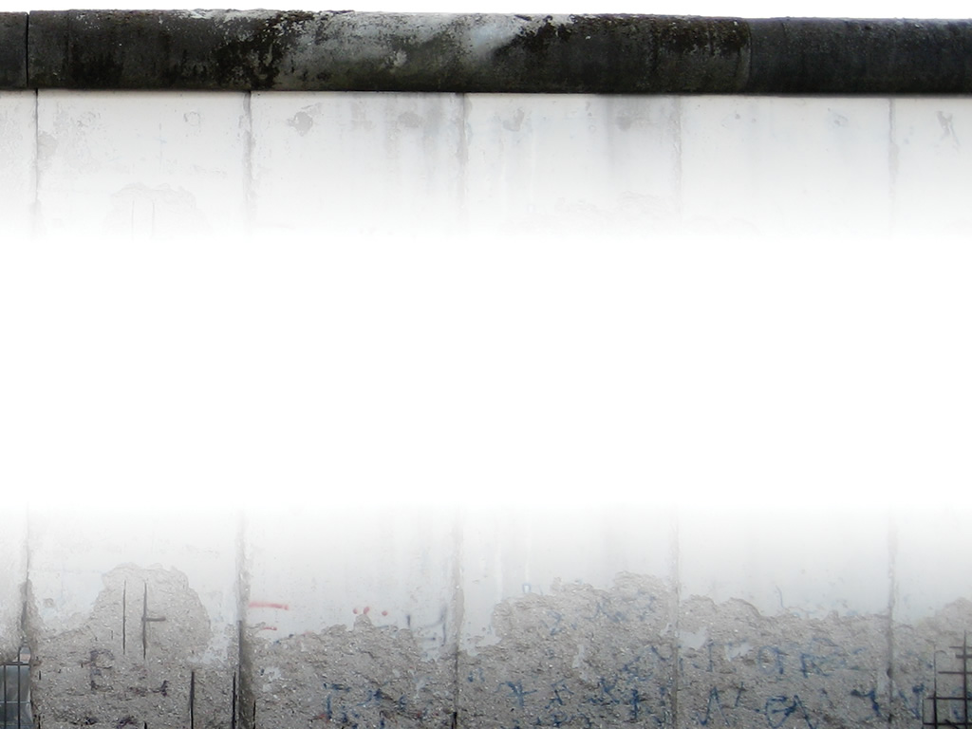
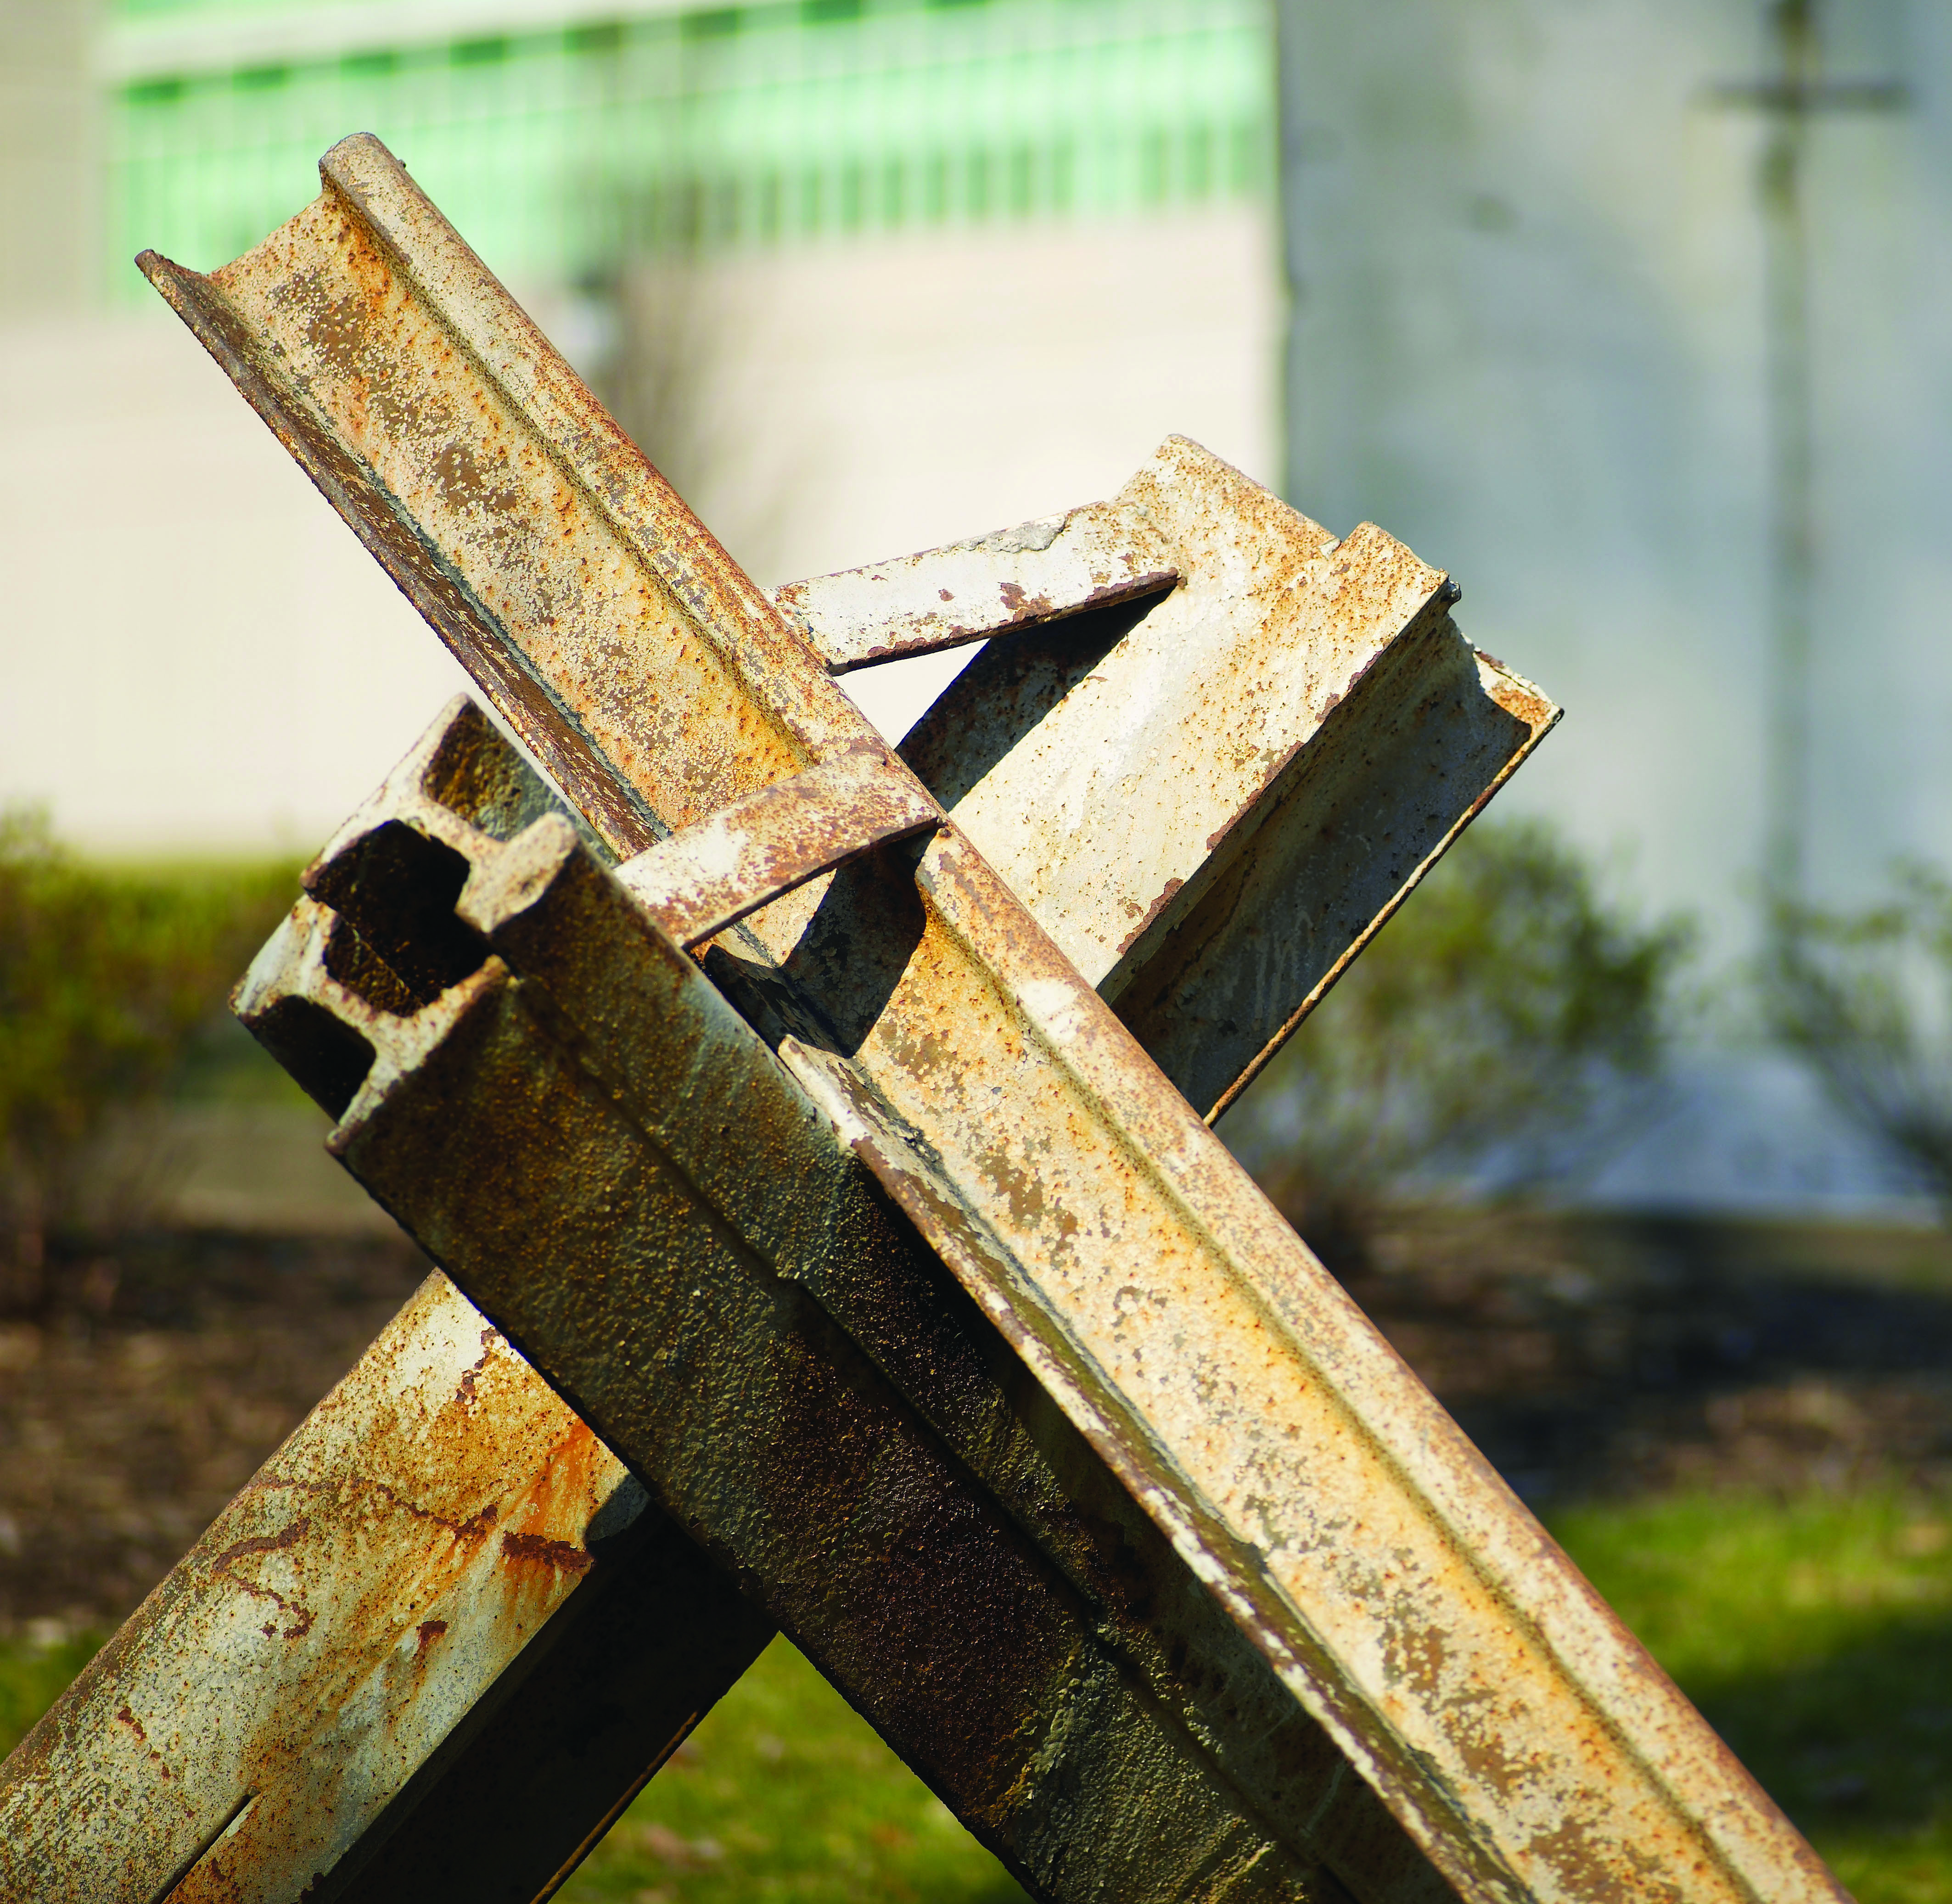

Crossing Barriers
Croesi Muriau
Week of Prayer for Christian Unity 2017
Yr Wythnos Weddi am Undeb Cristnogol 2017

Slide 2
Gathering
Y DOD YNGHYD
GATHERING

Slide 3
Slide 3
[ Naill ai / Either]
    Arweinydd
    Yn enw’r Tad, a’r Mab a’r Ysbryd Glân.
    Pawb
    Amen
    Leader
    In the name of the Father and of the Son and of the Holy Spirit.
    All
    Amen

Slide 4
Slide 4
[ Neu / or ]
    Arweinydd
    Yn enw Duw, Creawdwr, Waredwr a Chynhaliwr.
    Pawb
    Amen
    Leader
    In the name of God, Creator, Redeemer and Sustainer.
    All
    Amen

Slide 5
Slide 5
    Arweinydd
    Gras a thangnefedd i chi oddi wrth Dduw sydd wedi ein cymodi ni ag ef ei hun drwy Grist.
    Leader
    Grace and peace to you from God, who has reconciled us to himself through Christ.

Slide 6
Slide 6
    Arweinydd
    Eleni fe fydd nifer o Gristnogion yn dathlu pen-blwydd y Diwygiad yn yr Almaen. Fel y darganfu Luther ei fod ef wedi ei gymodi â Christ drwy ffydd, fe gofiwn ni fod Duw wedi ein cymodi ni drwy Iesu Grist, a’I gariad ef sy’n ein gorfodi ni i fod yn weinidogion cymod.
    Leader
    This year many Christians will be commemorating the anniversary of the Reformation in Germany. As Luther discovered himself reconciled to Christ by faith, we remember that God has reconciled us through Jesus Christ whose love compels us to be ministers of reconciliation.

Slide 7
Confessing
CYFFESU
CONFESSING

Slide 8
Slide 8
    Arweinydd
    Mae angen i’r Eglwys ddod yn nes at yr Iesu yn barhanol. Wrth i ni dyfu mewn cariad tuag at Grist, fe dyfwn mewn cariad tuag at ein gilydd. Ond wrth ymdrechu i wneud hyn, rydym wedi tyfu ar wahân ac ymrannu.
    Leader
    The Church always needs to grow closer to Jesus, for as we grow in
    love for Jesus we grow in love for each other. But as we have sought
    to do this we have instead grown apart and become divided.

Slide 9
Slide 9
    Arweinydd
    Gan gofio gweddi’r Iesu ei hun ar inni oll fod yn un er mwyn i’r byd ddod I gredu, cyffeswn ein pechodau a cheisiwn iachâd am y clwyfau yr ydym wedi achosi i’n gilydd o ganlyniad i’n rhaniadau.
    Leader
    Mindful that Jesus himself prayed that we may all be one, that the world might believe, let us confess
    our sins and seek healing for the wounds we have inflicted on each other as a result of our division.

Slide 10
Slide 10
    Distawrwydd
    Silence

Slide 11
Slide 11
    Arweinydd
    Cydnabyddwn gerbron Duw ein bod wedi methu bod yn feini byw iddo a’n bod wedi adeiladu muriau i’n gwahanu oddi wrth eraill.
    Leader
    We acknowledge before God that we have failed to be his living stones and have built walls of division.

Slide 12
Slide 12
    Darllenydd 1
    Y maen hwn yw ‘diffyg cariad’.
    Dduw grasol,
    mae cariad Crist yn ein gorfodi I geisio maddeuant am yr adegau
    pan ydym wedi methu caru.
    Reader 1
    This stone is ‘lack of love’.
    Gracious God,
    the love of Christ compels us to seek forgiveness for whenever we have failed to love.

Slide 13
Slide 13
    Darllenydd 2
    Y maen hwn yw ‘casineb a dirmyg’.
    Dduw grasol,
    mae cariad Crist yn ein gorfodi I geisio maddeuant am ein
    casineb a’n dirmyg tuag at eraill.
    Reader 2
    This stone is ‘hate and contempt’.
    Gracious God,
    the love of Christ compels us to seek forgiveness for our hate and contempt for one another.

Slide 14
Slide 14
    Darllenydd 3
    Y maen hwn yw ‘camgyhuddo.’
    Dduw grasol,
    mae cariad Crist yn ein gorfodi I geisio maddeuant am gondemnio a chamgyhuddo ein gilydd.
    Reader 3
    This stone is ‘false accusation.’
    Gracious God,
    the love of Christ compels us to seek forgiveness for denouncing and falsely accusing one another.

Slide 15
A Kyrie or another short invocation is sung
    Cenir Kyrie neu ryw ymbiliad arall.
    A Kyrie or another short invocation is sung.

Slide 16
Slide 16
    Darllenydd 4
    Y maen hwn yw ‘gwahaniaethu’.
    Dduw grasol,
    mae cariad Crist yn ein gorfodi i geisio maddeuant am bob math o ragfarn a gwahaniaethu yn erbyn ein gilydd.
    Reader 4
    This stone is ‘discrimination’.
    Gracious God,
    the love of Christ compels us to seek forgiveness for all forms of
    prejudice and discrimination against one another.

Slide 17
Slide 17
    Darllenydd 5
    Y maen hwn yw ‘erledigaeth’.
    Dduw grasol,
    mae cariad Crist yn ein gorfodi I geisio maddeuant am inni erlid
    ac arteithio ein gilydd.
    Reader 5
    This stone is ‘persecution’.
    Gracious God,
    the love of Christ compels us to seek forgiveness for persecuting and torturing one another.

Slide 18
Slide 18
    Darllenydd 6
    Y maen hwn yw ‘diffyg cyfathrebu.’
    Dduw grasol,
    mae cariad Crist yn ein gorfodi I geisio maddeuant am hybu’r
    diffyg cyfathrebu sy’n bod rhwng ein heglwysi.
    Reader 6
    This stone is ‘broken communion’.
    Gracious God,
    the love of Christ compels us to seek forgiveness for perpetuating broken communion among our churches.

Slide 19
A Kyrie or another short invocation is sung.
    Cenir Kyrie neu ryw ymbiliad arall.
    A Kyrie or another short invocation is sung.

Slide 20
Slide 20
    Darllenydd 7
    Y maen hwn yw ‘anoddefgarwch’.
    Dduw grasol,
    mae cariad Crist yn ein gorfodi I geisio maddeuant am weithredoedd sy’n cynnwys anoddefgarwch crefyddol yn hanesyddol a heddiw.
    Reader 7
    This stone is ‘intolerance’.
    Gracious God,
    the love of Christ compels us to seek forgiveness for acts of religious intolerance in history and today.

Slide 21
Slide 21
    Darllenydd 8
    Y maen hwn yw ‘rhyfeloedd crefyddol
    a gwrthdrawiadau’.
    Dduw grasol,
    mae cariad Crist yn ein gorfodi I geisio maddeuant am bob rhyfel a
    gwrthdrawiad a gychwynasom yn erbyn ein gilydd yn ei enw ef.
    Reader 8
    This stone is ‘religious wars and conflicts’.
    Gracious God,
    the love of Christ compels us to seek forgiveness for all wars and conflicts that we have waged against one another in his name.

Slide 22
Slide 22
    Darllenydd 9
    Y maen hwn yw ‘ymraniadau’.
    Dduw grasol,
    mae cariad Crist yn ein gorfodi i geisio maddeuant am fyw ein bywydau Cristnogol ar wahân i’n gilydd ac ymhell oddi wrth ein galwad gyffredin i iacháu yr holl greadigaeth.
    Reader 9
    This stone is ‘division’.
    Gracious God,
    the love of Christ compels us to seek forgiveness for living our Christian lives divided from one another and astray from our common calling for the healing of all creation.

Slide 23
A Kyrie or another short invocation is sung.
    Cenir Kyrie neu ryw ymbiliad arall.
    A Kyrie or another short invocation is sung.

Slide 24
Slide 24
    Darllenydd 10
    Y maen hwn yw ‘camddefnyddio grym’.
    Dduw grasol,
    mae cariad Crist yn ein gorfodi i geisio maddeuant am ein camddefnydd o rym.
    Reader 10
    This stone is ‘abuse of power’.
    Gracious God,
    the love of Christ compels us to seek forgiveness for our abuse
    of power.

Slide 25
Slide 25
    Darllenydd 11
    Y maen hwn yw ‘arwahanrwydd’.
    Dduw grasol,
    mae cariad Crist yn ein gorfodi I geisio maddeuant am yr adegau
    pan ydym wedi ceisio bod ar wahân i’n chwiorydd a’n brodyn
    Cristnogol a’r cymunedau yr ydym yn byw ynddynt.
    Reader 11
    This stone is ‘isolation’.
    Gracious God,
    the love of Christ compels us to seek forgiveness for the times when we have isolated ourselves from our Christian sisters and brothers and from the communities in which we live.

Slide 26
Slide 26
    Darllenydd 12
    Y maen hwn yw ‘balchder’.
    Dduw grasol,
    mae cariad Crist yn ein gorfodi i geisio maddeuant am ein balchder.
    Reader 12
    This stone is ‘pride’.
    Gracious God,
    the love of Christ compels us to seek forgiveness for our pride.

Slide 27
Slide 27
    Pawb
    Arglwydd, ein Duw,
    edrycha ar y mur yr ydym wedi ei godi,
    sy’n ein gwahanu oddi wrthyt ac oddi
    wrth ein gilydd.
    All
    Lord, our God,
    look upon this wall that we have built,
    which separates us from you and from one another.

Slide 28
Slide 28
    Pawb
    Maddeua ein pechodau ac iacha ni.
    Helpa ni i oresgyn yr holl furiau sy’n
    ein gwahanu
    a gwna ni’n un ynot ti. Amen.
    All
    Forgive us our sins and heal us.
    Help us to overcome all walls of division
    and make us one in you. Amen.

Slide 29
Slide 29
    Arweinydd
    Rhodded yr Arglwydd galon newydd ac
    ysbryd newydd o’ch mewn;
    tynned ymaith ohonoch eich calon garreg
    a rhoi ichi galon o gnawd;
    Leader
    May God give you a new heart and a new spirit
    remove your heart of stone
    give you a new heart of flesh

Slide 30
Slide 30
    Arweinydd
    rhodded ysbryd newydd ynoch
    er mwyn i chi rodio ffyrdd Duw a
    charu gorchmynion Duw.
    (Seiliedig ar Eseciel 36:25-27)
    Leader
    put a new Spirit within you
    so that you may walk in God’s ways and love
    God’s commandments.
    (Based on Ezekiel 36:25-27)

Slide 31
The Peace
Y TANGNEFEDD
THE PEACE

Slide 32
Slide 32
    Arweinydd
    Crist yw ein heddwch ni, ef a’n gwnaeth ni’n un a thrwy ei gnawd ei hun fe chwalodd y canolfur o elyniaeth a oedd yn ein gwahanu. (Eff. 2.14)
    Tangnefedd yr Arglwydd a fo gyda chwi bob amser.
    Leader
    Christ is our peace, he has made us one and has broken down in his flesh the dividing wall of hostility. (Eph. 2.14)
    The peace of the Lord be with you always.

Slide 33
Slide 33
    Pawb
    A hefyd gyda thi.
    All
    And also with you.

Slide 34
A sign of peace is exchanged
    Rhennir arwydd tangnefedd.
    A sign of peace is exchanged

Slide 35
Hymn, song or meditative music
    Cenir emyn neu gân neu chwaraeir darn o
    gerddoriaeth fyfyriol.
    Hymn, song or meditative music

Slide 36
Hearing
GWRANDO
HEARING

Slide 37
Epistle
    Yr Epistol
    2 Corinthiaid 5:14-20
    Epistle
    2 Corinthians 5:14-20

Slide 38
Slide 38
    Oherwydd y mae cariad Crist yn ein gorfodi ni, a ninnau wedi ein hargyhoeddi o hyn: i un farw dros bawb, ac felly i bawb farw. A bu ef farw dros bawb er mwyn i’r byw beidio â byw iddynt eu hunain mwyach, ond i’r un a fu farw drostynt, ac a gyfodwyd.
    For the love of Christ urges us on, because we are convinced that one has died for all; therefore all have died. And he died for all, so that those who live might live no longer for themselves, but for him who died and was raised for them.
    1/4

Slide 39
Slide 39
    O hyn allan, felly, nid ydym yn ystyried neb o safbwynt dynol. Hyd yn oed os buom yn ystyried Crist o safbwynt dynol, nid ydym yn ei ystyried felly mwyach. Felly, os yw rhywun yng Nghrist, y mae’n greadigaeth newydd; aeth yr hen heibio, y mae’r newydd yma.
    From now on, therefore, we regard no one from a human point of view; even though we once knew Christ from a human point of view, we know him no longer in that way. So if anyone is in Christ, there is a new creation: everything old has passed away; see, everything has become new!
    2/4

Slide 40
Slide 40
    Ond gwaith Duw yw’r cyfan—Duw, yr hwn sydd wedi ein cymodi ni ag ef ei hun trwy Grist a rhoi i ni weinidogaeth y cymod. Hynny yw, yr oedd Duw yng Nghrist yn cymodi’r byd ag ef ei hun, heb ddal neb yn gyfrifol am ei droseddau, ac y mae wedi ymddiried i ni neges y cymod.
    All this is from God, who reconciled us to himself through Christ, and has given us the ministry of reconciliation; that is, in Christ God was reconciling the world to himself, not counting their trespasses against them, and entrusting the message of reconciliation to us.
    3/4

Slide 41
Slide 41
    Felly cenhadon dros Grist ydym ni, fel pe bai Duw yn apelio atoch trwom ni. Deisyf yr ydym dros Grist, cymoder chwi â Duw.
    So we are ambassadors for Christ, since God is making his appeal through us; we entreat you on behalf of Christ, be reconciled to God.
    4/4

Slide 42
Responsorial Psalm
    Salm Ateb : 18:26-32
    Responsorial Psalm: 18:26-32

Slide 43
Slide 43
    Caraf di, O Arglwydd, fy nghryfder
    Yr wyt yn ffyddlon i’r ffyddlon
    ond i’r cyfeiliornus yr wyt yn wyrgam.
    Oherwydd yr wyt yn gwaredu’r rhai gostyngedig
    ac yn darostwng y beilchion. A./
    I love you, Lord, my strength.
    You are loving with those who love you:
    but the cunning you outdo in cunning.
    For you save a humble people
    but humble the eyes that are proud. R./
    1/4

Slide 44
Slide 44
    Ti sy’n goleuo fy llusern, Arglwydd,
    fy Nuw sy’n troi fy nhywyllwch yn ddisglair.
    Oherwydd trwot ti y gallaf oresgyn llu;
    trwy fy Nuw gallaf neidio dros fur. A./
    You, O Lord, are my lamp,
    my God who lightens my darkness.
    With you I can break through any barrier,
    with my God I can scale any wall. R./
    2/4
    /4

Slide 45
Slide 45
    Y Duw hwn, y mae’n berffaith ei ffordd
    ac y mae gair yr Arglwydd wedi ei brofi’n bur.
    Y mae ef yn darian i bawb sy’n llochesu ynddo. A./
    As for God, his ways are perfect;
    the word of the Lord, purest gold.
    He indeed is the shield
    of all who make him their refuge. R./
    3/4
    /4

Slide 46
Slide 46
    Pwy sydd Dduw ond yr Arglwydd?
    A phwy sydd graig ond ein Duw ni,
    y Duw sy’n fy ngwregysu â nerth,
    ac yn gwneud fy ffordd yn ddifeius? A./
    Alelwia
    For who is God but the Lord?
    Who is a rock but our God?
    the God who girds me with strength
    and makes the path safe before me. R./
    Alleluia
    4/4

Slide 47
Gospel reading
    Yr Efengyl
    Luc 15:11-32
    Gospel Reading
    Luke 15:11-32

Slide 48
Slide 48
    Ac meddai, “Yr oedd dyn a chanddo ddau fab. Dywedodd yr ieuengaf ohonynt wrth ei dad, ‘Fy nhad, dyro imi’r gyfran o’th ystad sydd i ddod imi.’ A rhannodd yntau ei eiddo rhyngddynt.
    Jesus said, “There was a man who had two sons. The younger of them said to his father, ‘Father, give me the share of the property that will belong to me.’ So he divided his property between them.
    1/7

Slide 49
Slide 49
    Ychydig ddyddiau yn ddiweddarach, wedi newid y cwbl am arian, ymfudodd y mab ieuengaf i wlad bell, ac yno gwastraffodd ei eiddo ar fyw’n afradlon. Pan oedd wedi gwario’r cyfan, daeth newyn enbyd ar y wlad honno, a dechreuodd yntau fod mewn eisiau. Aeth ac ymlynu wrth un o ddinasyddion y wlad, ac anfonodd hwnnw ef i’w gaeau i ofalu am y moch.
    A few days later the younger son gathered all he had and travelled to a distant country, and there he squandered his property in dissolute living. When he had spent everything, a severe famine took place throughout that country, and he began to be in need. So he went and hired himself out to one of the citizens of that country, who sent him to his fields to feed the pigs.
    2/7

Slide 50
Slide 50
    Buasai’n falch o wneud pryd o’r plisg yr oedd y moch yn eu bwyta; ond nid oedd neb yn cynnig dim iddo. Yna daeth ato’i hun a dweud, ‘Faint o weision cyflog sydd gan fy nhad, a phob un ohonynt yn cael mwy na digon o fara, a minnau yma yn marw o newyn? Fe godaf, ac fe af at fy nhad a dweud wrtho, “Fy nhad, pechais yn erbyn y nef ac yn dy erbyn di. Nid wyf mwyach yn haeddu fy ngalw’n fab iti; cymer fi fel un o’th weision cyflog.” ’
    He would gladly have filled himself with the pods that the pigs were eating; and no one gave him anything. But when he came to himself he said, ‘How many of my father’s hired hands have bread enough and to spare, but here I am dying of hunger! I will get up and go to my father, and I will say to him, “Father, I have sinned against heaven and before you; I am no longer worthy to be called your son; treat me like one of your hired hands.” ’
    3/7

Slide 51
Slide 51
    Yna cododd a mynd at ei dad. A phan oedd eto ymhell i ffwrdd, gwelodd ei dad ef. Tosturiodd wrtho, rhedodd ato, a rhoes ei freichiau am ei wddf a’i gusanu. Ac meddai ei fab wrtho, ‘Fy nhad, pechais yn erbyn y nef ac yn dy erbyn di. Nid wyf
    mwyach yn haeddu fy ngalw’n fab iti.’ Ond meddai ei dad wrth ei weision, ‘Brysiwch! Dewch â gwisg allan, yr orau, a’i gosod amdano. Rhowch fodrwy ar ei fys a sandalau am ei draed. Dewch â’r llo sydd wedi ei besgi, a lladdwch ef. Gadewch inni wledda a llawenhau, oherwydd yr oedd hwn, fy mab, wedi marw, a daeth yn fyw eto; yr oedd ar goll, a chafwyd hyd iddo.’
    So he set off and went to his father. But while he was still far off, his father saw him and was filled with compassion; he ran and put his arms around him and kissed him. Then the son said to him, ‘Father, I have sinned against heaven and before you; I am no longer worthy to be called your son. ’ But the father said to his slaves, ‘Quickly, bring out a robe—the best one—and put it on him; put a ring on his finger and sandals on his feet. And get the fatted calf and kill it, and let us eat and celebrate; for this son of mine was dead and is alive again; he was lost and is found!’
    4/7

Slide 52
Slide 52
    Yna dechreusant wledda yn llawen. Yr oedd ei fab hynaf yn y caeau. Pan nesaodd at y tŷ ar ei ffordd adref, clywodd sŵn cerddoriaeth a dawnsio. Galwodd un o’r gweision ato a gofyn beth oedd ystyr hyn. ‘Dy frawd sydd wedi dychwelyd,’ meddai ef wrtho, ‘ac am iddo ei gael yn ôl yn holliach, y mae dy dad wedi lladd y llo oedd wedi ei besgi.’
    And they began to celebrate.
    Now his elder son was in the field; and when he came and approached the house, he heard music and dancing. He called one of the slaves and asked what was going on. He replied, ‘Your brother has come, and your father has killed the fatted calf, because he has got him back safe and sound.’
    5/7

Slide 53
Slide 53
    Digiodd ef, a gwrthod mynd i mewn. Daeth ei dad allan a’i gymell yn daer i’r tŷ, ond atebodd ef, ‘Yr holl flynyddoedd hyn bûm yn was bach iti, heb anufuddhau erioed i’th orchymyn. Ni roddaist erioed i mi gymaint â myn gafr, imi gael gwledda gyda’m cyfeillion. Ond pan ddychwelodd hwn, dy fab sydd wedi difa dy eiddo gyda phuteiniaid, lleddaist iddo ef y llo oedd wedi ei besgi.’
    Then he became angry and refused to go in. His father came out and began to plead with him. But he answered his father, ‘Listen! For all these years I have been working like a slave for you, and I have never disobeyed your command; yet you have never given me even a young goat so that I might celebrate with my friends. But when this son of yours came back, who has devoured your property with prostitutes; you killed the fatted calf for him!’
    6/7

Slide 54
Slide 54
    ‘Fy mhlentyn,’ meddai’r tad wrtho, ‘yr wyt ti bob amser gyda mi, ac y mae’r cwbl sydd gennyf yn eiddo i ti. Yr oedd yn rhaid gwledda a llawenhau, oherwydd yr oedd hwn, dy frawd, wedi marw, a daeth yn fyw; yr oedd ar goll, a chafwyd hyd iddo.’ ”
    Alelwia
    Then the father said to him, ‘Son, you are always with me, and all that is mine is yours. But we had to celebrate and rejoice, because this brother of yours was dead and has come to life; he was lost and has been found.’”
    Alleluia
    7/7

Slide 55
Sermon
PREGETH
SERMON

Slide 56
Creed
CREDO
CREED

Slide 57
Slide 57
    Credwn yn un Duw,
    Y Tad, yr hollalluog,
    gwneuthurwr nef a daear,
    a phob peth gweledig ac anweledig.
    We believe in one God,
    the Father, the Almighty,
    maker of heaven and earth,
    of all that is, seen and unseen.
    1/7

Slide 58
Slide 58
    Credwn yn un Arglwydd Iesu Grist,
    unig Fab Duw,
    a genhedlwyd gan y Tad cyn yr holl oesoedd,
    Duw o Dduw, Llewyrch o Lewyrch,
    gwir Dduw o wir Dduw,
    wedi ei genhedlu, nid wedi ei wneuthur,
    yn un hanfod â’r Tad,
    a thrwyddo ef y gwnaed pob peth.
    We believe in one Lord, Jesus Christ,
    the only Son of God,
    eternally begotten of the Father,
    God from God, Light from Light,
    true God from true God,
    begotten, not made,
    of one Being with the Father;
    through him all things were made.
    2/7

Slide 59
Slide 59
    Er ein mwyn ni ac er ein hiachawdwriaeth
    disgynnodd o’r nefoedd;
    trwy nerth yr Ysbryd Glân daeth yn gnawd o Fair Forwyn,
    ac fe’i gwnaed yn ddyn,
    For us and for our salvation
    he came down from heaven,
    was incarnate of the Holy Spirit and the Virgin Mary
    and became truly human.
    3/7

Slide 60
Slide 60
    Fe’i croeshoeliwyd drosom dan Pontius Pilat.
    Dioddefodd angau ac fe’i claddwyd.
    Atgyfododd y trydydd dydd yn ôl yr Ysgrythurau,
    For our sake he was crucified under Pontius Pilate;
    he suffered death and was buried.
    On the third day he rose again
    in accordance with the Scriptures;
    4/7

Slide 61
Slide 61
    ac esgynnodd i’r nef,
    ac y mae’n eistedd ar ddeheulaw’r Tad.
    A daw drachefn mewn gogoniant
    i farnu’r byw a’r meirw:
    ac ar ei deyrnas ni bydd diwedd.
    he ascended into heaven
    and is seated at the right hand of the Father.
    He will come again in glory to judge the living and the dead,
    and his kingdom will have no end.
    5/7

Slide 62
Slide 62
    Credwn yn yr Ysbryd Glân,
    yr Arglwydd, rhoddwr bywyd,
    sy’n deillio o’r Tad a’r Mab,
    ac ynghyd â’r Tad a’r Mab
    a gydaddolir ac a gydogoneddir,
    ac a lefarodd trwy’r proffwydi.
    We believe in the Holy Spirit, the Lord, the giver of life,
    who proceeds from the Father [and the Son],
    who with the Father and the Son is worshiped and glorified,
    who has spoken through the prophets.
    6/7

Slide 63
Slide 63
    Credwn yn un Eglwys lân gatholig ac apostolig.
    Cydnabyddwn un bedydd er maddeuant pechodau.
    A disgwyliwn am atgyfodiad y meirw,
    a bywyd y byd sydd i ddyfod.
    Amen.
    We believe in one holy catholic and apostolic Church.
    We acknowledge one baptism for the forgiveness of sins.
    We look for the resurrection of the dead,
    and the life of the world to come. Amen.
    7/7

Slide 64
Slide 64
    Arweinydd
    Rhodded yr Arglwydd galon newydd ac
    ysbryd newydd o’ch mewn;
    tynned ymaith ohonoch eich calon garreg
    a rhoi ichi galon o gnawd;
    rhodded ysbryd newydd ynoch
    er mwyn i chi rhodio ffyrdd Dduw a charu
    gorchmynion Duw.
    (Seiliedig ar Eseciel 36:25-27)
    Leader
    May God give you a new heart and a new spirit
    remove your heart of stone
    give you a new heart of flesh
    put a new Spirit within you
    so that you may walk in God’s ways and love
    God’s commandments.
    (Based on Ezekiel 36:25-27)

Slide 65
The Peace
Y TANGNEFEDD
THE PEACE

Slide 66
Slide 66
    Arweinydd
    Crist yw ein heddwch ni, ef a’n gwnaeth ni’n un a thrwy ei gnawd ei hun fe chwalodd y canolfur o elyniaeth oedd yn ein gwahanu. (Eff. 2.14)
    Tangnefedd yr Arglwydd a fo gyda chwi bob amser.
    Pawb
    A hefyd gyda thi.
    Leader
    Christ is our peace, he has made us one and has broken down in his flesh the dividing wall of hostility. (Eph. 2.14)
    The peace of the Lord be with you always.
    All
    And also with you

Slide 67
A sign of peace is exchanged
    Rhennir arwydd y tangnefedd.
    A sign of peace is exchanged

Slide 68
Responding
YMATEB
RESPONDING

Slide 69
Slide 69
    Arweinydd
    Bu farw’r cyfan sy’n ein gwahanu oddi wrth Dduw gyda Christ ar y Groes.
    Gan ein bod ni unwaith eto’n un ag ef, ymrwymwn ein hunain,
    yn nerth ei Ysbryd,
    i dymchwel y muriau sy’n ein gwahanu ac I fod yn un â’n gilydd,
    er mwyn i enw Crist gael ei ogoneddu,
    i’r deyrnas ddod, ac er mwyn gwneud ewyllys Duw.
    Leader
    All that divides us from God died with Christ on the cross.
    As we are again one with him, we commit ourselves,
    in the power of his Spirit,
    to break down our divisions and become one with each other,
    so that Christ’s name be glorified, the kingdom come and God’s will be done.

Slide 70
A song of reconciliation
    Cenir cân o gymod neu emyn yn dathlu gogoniant y groes tra dymchwelir y mur a’i ailffurfio ar lun croes.
    A song of reconciliation or hymn of the glory of the cross while the wall is dismantled and formed in the shape of a cross.

Slide 71
Intercessory prayers
YR YMBILIAU
INTERCESSORY PRAYERS

Slide 72
Slide 72
    Darllenydd 1
    Hollalluog Dduw,
    anfonaist dy Fab Iesu Grist er mwyn cymodi’r byd â thi dy hun.
    Reader 1
    Almighty God,
    you sent your son Jesus Christ to reconcile the world to yourself.

Slide 73
Slide 73
    Darllenydd 1
    Canmolwn di oherwydd trwy dy Efengyl,
    gelwaist ynghyd gymuned o gariad ym mhob rhan o’r ddaear,
    ac am fod modd i’th weision ym mhob man alw ar dy enw.
    Boed i’th Ysbryd ennyn ym mhob cymuned newyn a syched am undod.
    Reader 1
    We praise you because through your Gospel,
    in all parts of the earth a community of love has been gathered together,
    and that in every place your servants call upon your name.
    May your Spirit awaken in every community a hunger and thirst for unity.

Slide 74
Slide 74
    Darllenydd 1
    Ragweed, yn dy drugaredd,
    Pawb
    Gwrando ein gweddi
    Reader 1
    Lord, in your mercy,
    All
    Hear our prayer

Slide 75
Slide 75
    Darllenydd 2
    Dduw grasol,
    gweddïwn dros ein heglwysi.
    Llanw hwy â phob gwirionedd
    a thangnefedd.
    Lle bo ffydd yn llygredig, pura hi;
    lle bo pobl ar gyfeiliorn,
    ailgyfeiria hwy;
    Reader 2
    Gracious God,
    we pray for our churches. Fill them with all truth and peace.
    Where faith is corrupt, purify it;
    where people go astray, redirect them;

Slide 76
Slide 76
    Darllenydd 2
    lle maent yn methu â chyhoeddi’r Efengyl, diwygia hwy;
    lle maent yn tystio i’r hyn sy’n iawn, nertha hwy;
    lle maent mewn angen, darpara ar eu cyfer;
    lle maent ar wahân i’w gilydd, una hwy.
    Reader 2
    where they fail to proclaim your Gospel, reform them;
    where they witness to what is right, strengthen them;
    where they are in need, provide for them;
    and where they are divided, reunite them.

Slide 77
Slide 77
    Darllenydd 2
    Arglwydd, yn dy drugaredd,
    Pawb this
    Gwrando ein gweddi
    Reader 2
    Lord, in your mercy,
    All
    Hear our prayer

Slide 78
Slide 78
    Darllenydd 3
    Dduw y Creawdwr,
    gwnaethost ni ar dy lun a’th ddelw dy hun ac achubaist ni trwy Iesu
    Grist dy Fab.
    Reader 3
    Creator God,
    you made us in your own image and redeemed us through Jesus
    Christ your Son.

Slide 79
Slide 79
    Darllenydd 3
    Bydd yn drugarog wrth yr holl deulu dynol;
    cymer ymaith y balchder a’r casineb sy’n gwenwyno ein calonnau;
    dymchwel y muriau sy’n ein gwahanu, ac una ni â rhwymyn cariad.
    Reader 3
    Look with compassion on the whole human family;
    take away the arrogance and hatred that infect our hearts;
    break down the walls that separate us, and unite us in bonds of love.

Slide 80
Slide 80
    Darllenydd 3
    Defnyddia hyd yn oed ein gwendid I gyflawni dy fwriadau ar y ddaear,
    er mwyn i bob person a chenedl dy wasanaethu mewn cytgord o
    amgylch yr orsedd nefol.
    Reader 3
    Even through our weaknesses, work to accomplish your purposes on earth,
    so that every people and nation may serve you in harmony around your
    heavenly throne.

Slide 81
Slide 81
    Darllenydd 3
    Arglwydd, yn dy drugaredd,
    All
    Gwrando ein gweddi
    Reader 3
    Lord, in your mercy,
    All
    Hear our prayer

Slide 82
Slide 82
    Darllenydd 4
    Ysbryd Glân, Rhoddwr Bywyd,
    Crëir ni i ddod yn gyflawn ynot ti
    ac i rannu’r bywyd hwn ar y ddaear gyda’n brodyr a’n chwiorydd.
    Deffra ym mhawb ohonom dosturi a chariad.
    Reader 4
    Holy Spirit, Giver of Life,
    we are created to become whole in you
    and to share this life on earth with our brothers and sisters.
    Awaken in each of us your compassion and love.

Slide 83
Slide 83
    Darllenydd 4
    Rho inni nerth a gwroldeb i weithio dros gyfiawnder yn ein cymunedau,
    i greu heddwch o fewn ein teuluoedd,
    i gysuro’r claf a’r rhai sy’n marw,
    ac i rannu’r cyfan sydd gennym gyda’r rhai sydd mewn angen.
    Am drawsnewid pob calon ddynol, gweddïwn:
    Reader 4
    Give us strength and courage to work for justice in our neighbourhoods,
    to create peace within our families,
    to comfort the sick and the dying,
    and to share all we have with those who are in need.
    For the transformation of every human heart, we pray:

Slide 84
Slide 84
    Darllenydd 4
    Arglwydd, yn dy drugaredd,
    All
    Gwrando ein gweddi
    Reader 4
    Lord, in your mercy,
    All
    Hear our prayer

Slide 85
The Lord’s Prayer
GWEDDI’R ARGLWYDD
THE LORD’S PRAYER

Slide 86
Sending
YR ANFON ALLAN
SENDING

Slide 87
A hymn is sung
    Cenir emyn.
    A hymn is sung.

Slide 88
Slide 88
    Arweinydd
    Iesu yw goleuni’r byd, goleuni na all y
    tywyllwch ei drechu.
    Ewch â’i oleuni i’r byd, i lefydd tywyll lle mae ymladd, anghytgord a
    rhaniadau yn rhwystro ein tystiolaeth unedig.
    Bydded i oleuni Crist ddod â chymod i’n meddyliau, i’n geiriau a’n gweithredoedd.
    Leader
    Jesus is the light of the world, a light that darkness cannot overcome.
    Carry his light into the world, into the dark places where fighting,
    discord and division impede our united witness.
    May Christ´s light effect reconciliation in our thoughts, words and deeds.

Slide 89
Blessing
Y FENDITH
BLESSING

Slide 90
Slide 90
    Arweinydd
    Galwn arnat, Dduw drugarocaf:
    Bendithia ac annog pawb sy’n ceisio cymod
    fel y gallont adnabod a chyhoeddi dy fawr weithredoedd o gariad.
    Gofynnwn am hyn yn enw Iesu Grist, dy fab, ein Harglwydd.
    Leader
    We call out to you, most merciful God:
    Bless and encourage all those who seek reconciliation
    so they may know and proclaim your mighty deeds of love.
    We ask this in the name of Jesus Christ, your son, our Lord.

Slide 91
Slide 91
    Pawb
    Amen
    All
    Amen

Slide 92
Slide 92
[ Naill ai / Either]
    Arweinydd
    Bendith Duw Hollalluog,
    y Tad, a’r Mab, a’r Ysbryd Glân
    a fo yn eich plith ac a drigo gyda chwi yn wastad.
    Leader
    May the blessing of Almighty God,
    the Father, and the Son, and the Holy Spirit
    be upon you and remain with you always.

Slide 93
Slide 93
    Pawb
    Amen
    All
    Amen

Slide 94
Slide 94
[ Neu / or ]
    Arweinydd
    Bendith Duw Hollalluog,
    Creawdwr, Waredwr a Chynhaliwr
    a fo yn eich plith ac a drigo gyda chwi yn wastad.
    Leader
    May the blessing of Almighty God,
    Creator, Redeemer and Sustainer
    be upon you and remain with you always.

Slide 95
Slide 95
    Pawb
    Amen
    All
    Amen

Slide 96
Slide 96
    Arweinydd
    Ewch mewn tangnefedd i garu a gwasanaethu’r Arglwydd.
    Pawb
    Diolch a fo i Dduw
    Leader
    Go in Peace to love and serve the Lord.
    All
    Thanks be to God

Slide 97
Credits
Croesi Muriau
Crossing Barriers
Dyfyniadau o’r Beibl o Y Beibl Cymraeg Newydd, hawlfraint 1988, 2004. Y Gymdeithas Feiblaidd Frytanaidd a Thramor. Wedi eu defnyddio trwy ganiatâd.
Bible verses from the New Revised Standard Version Bible: Anglicized Edition, copyright 1989, 1995, Division of Christian Education of the National Council of the Churches of Christ in the United States of America. Used by permission. All rights reserved.
Clodrestr Ffotograffau / Photos: Gwaith Llywodraeth yr Unol Dalaeth / United States government work
Mur Berlin / Berlin wall: Jeff Keyzer (www.flickr.com/photos/mightyohm/3860393026/)

