Slide 1
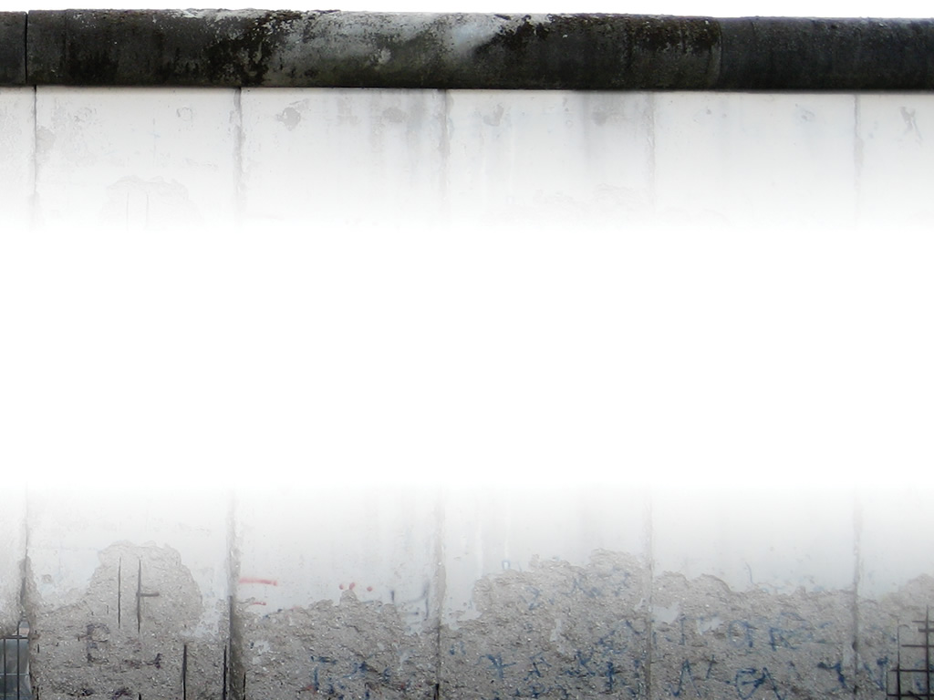
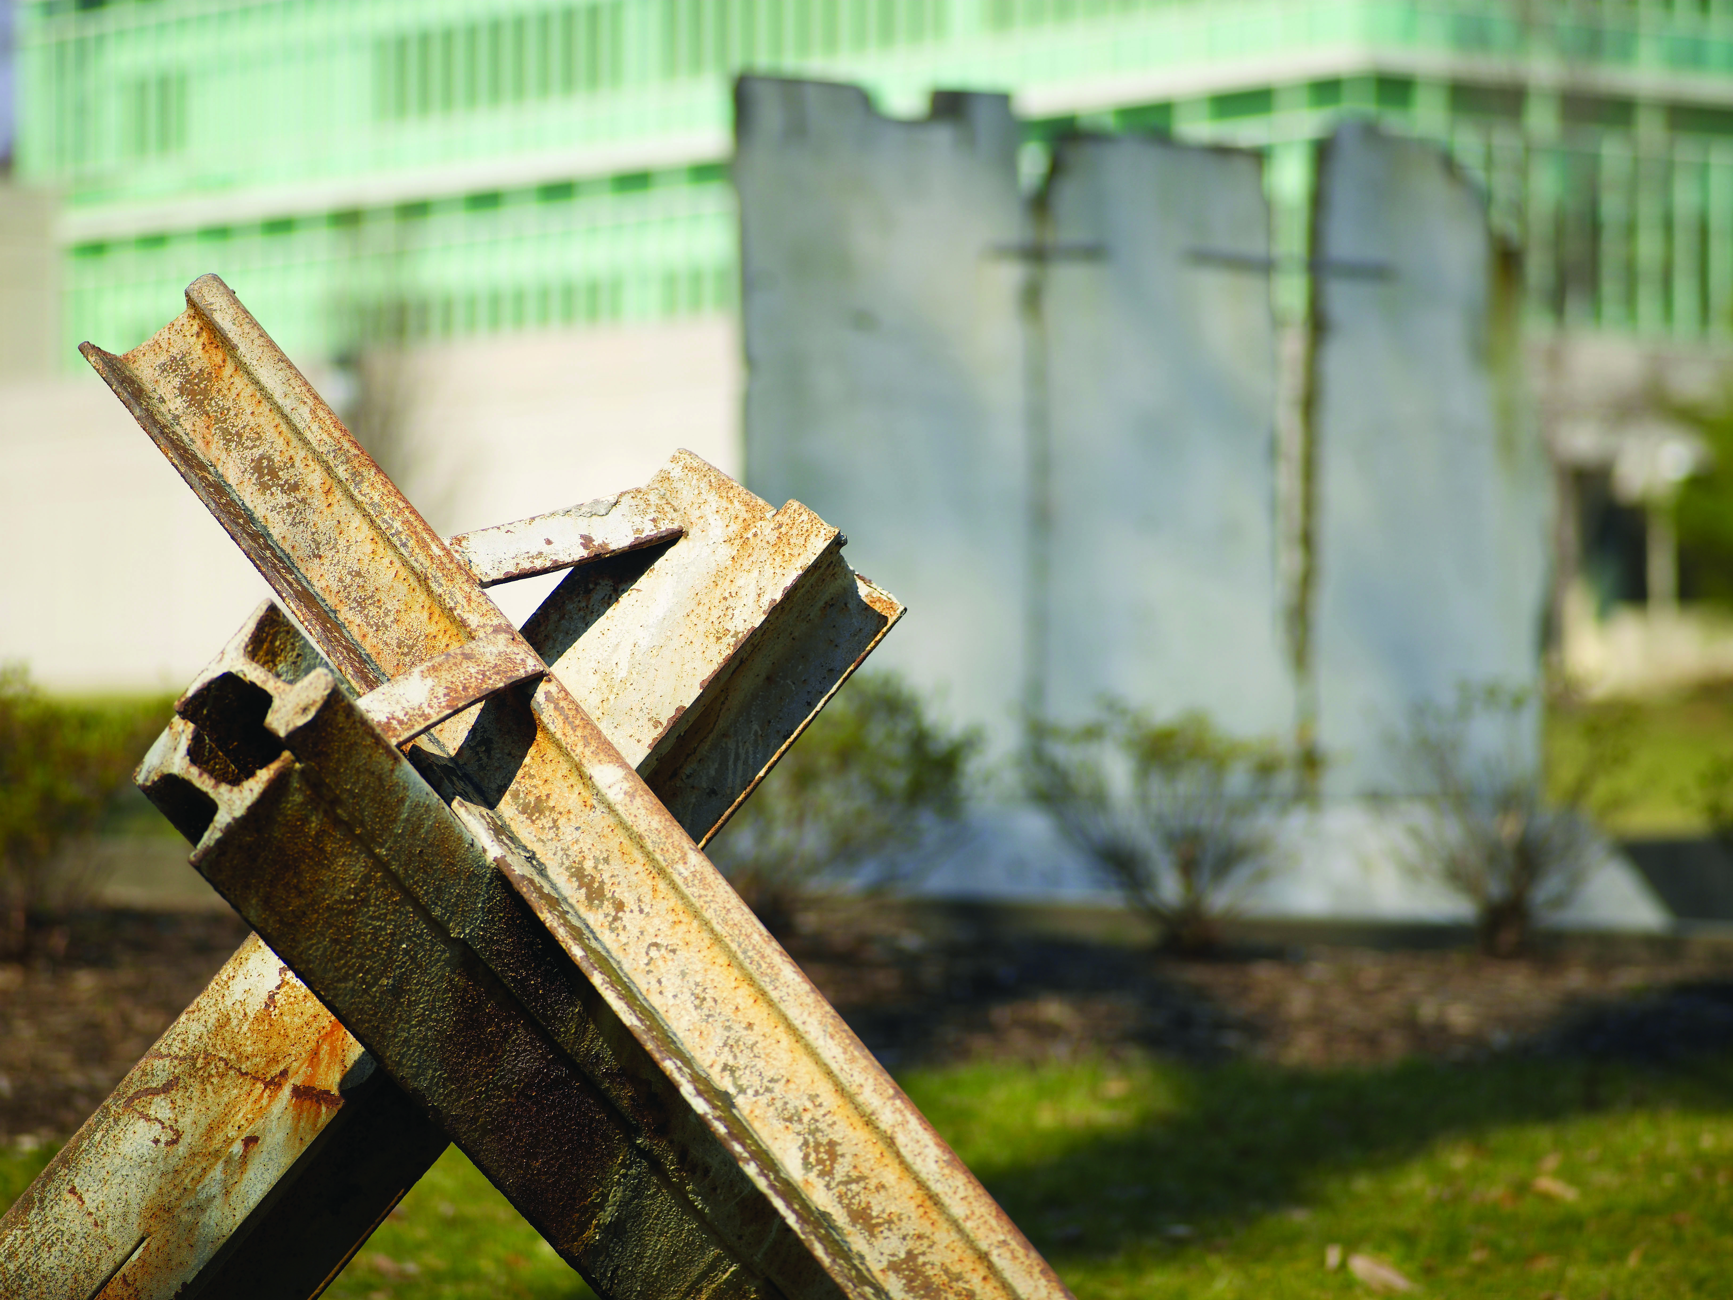

Crossing Barriers
Croesi Muriau
Week of Prayer for Christian Unity 2017
Yr Wythnos Weddi am Undeb Cristnogol 2017

Slide 2
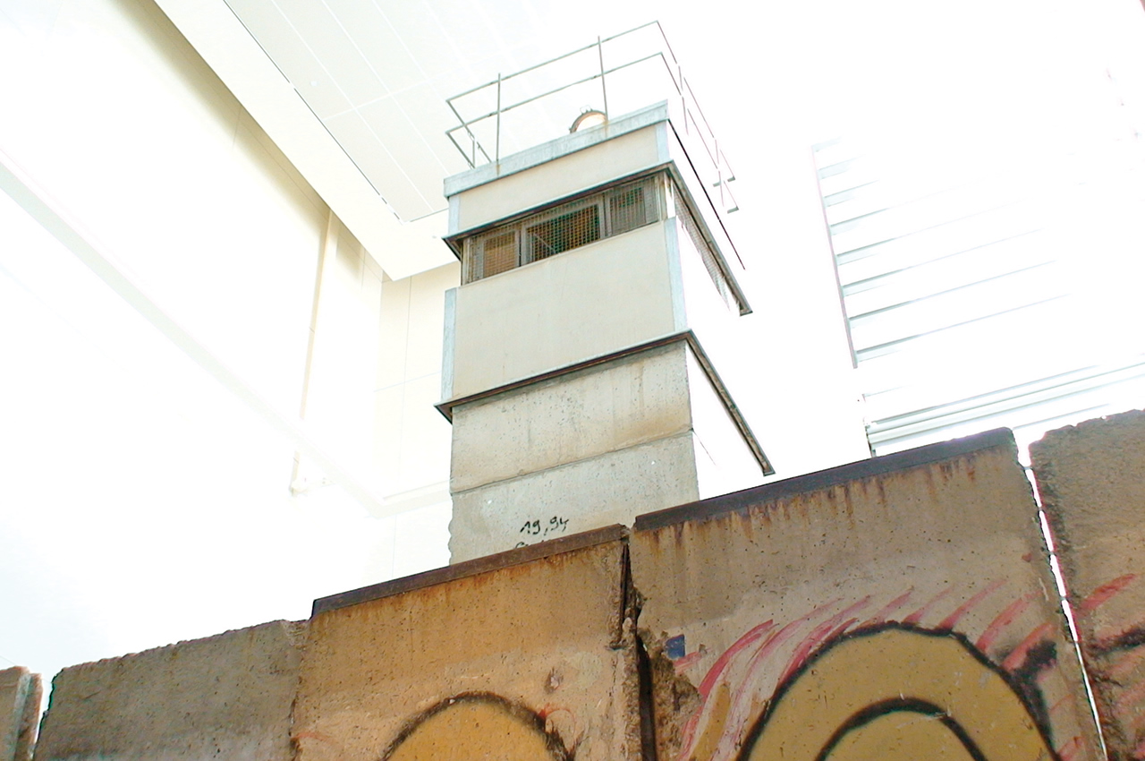
Mur Berlin a’r tŵr gwylio
Berlin Wall and watch tower

Slide 3
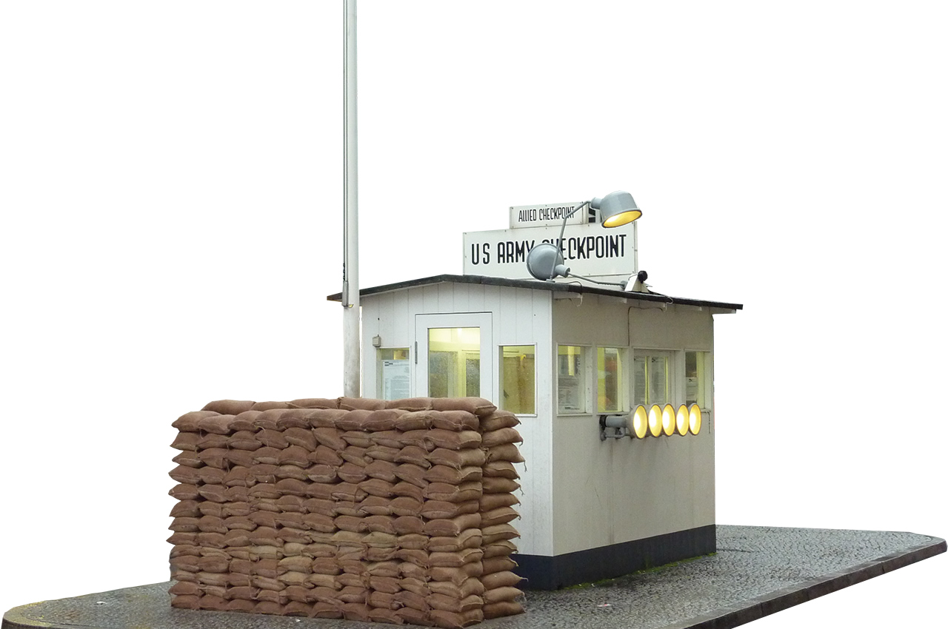
Rheolfa Charlie
Checkpoint Charlie

Slide 4
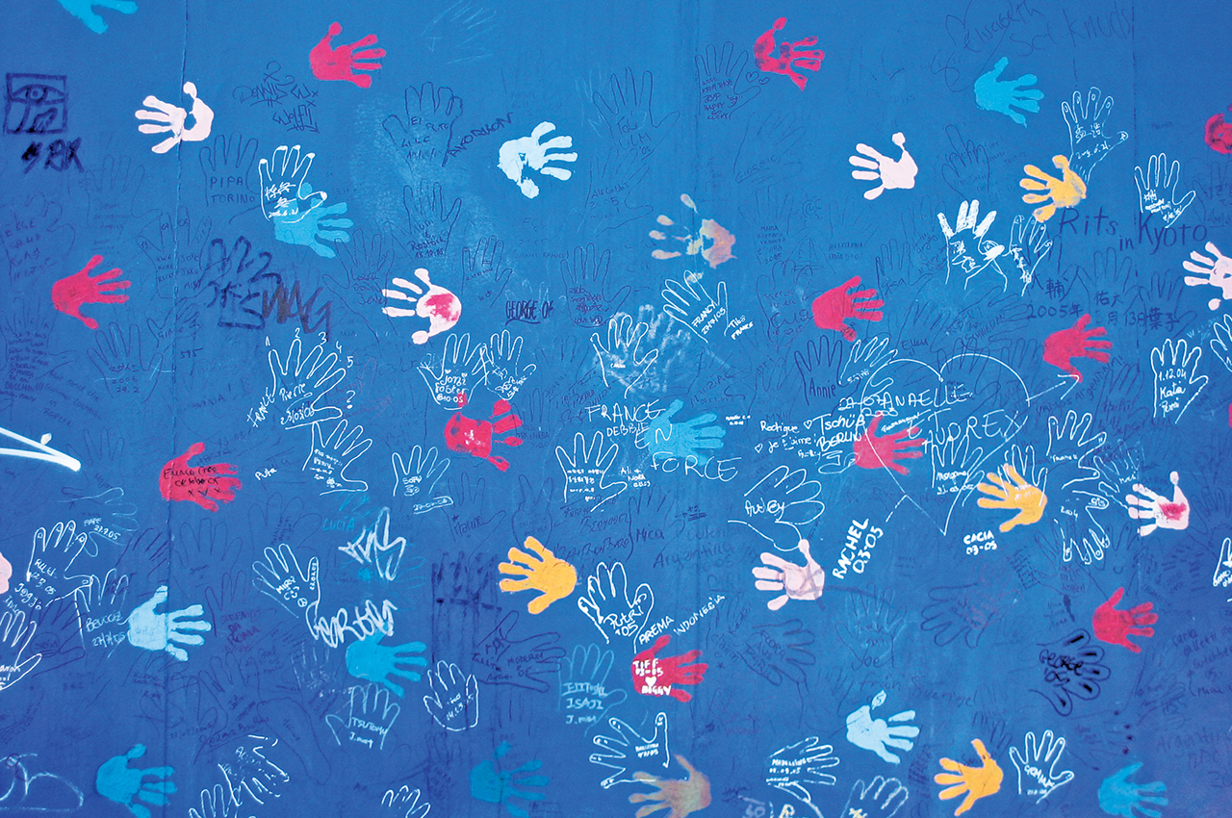
Bu un farw dros bawb
One has died for all
Celf Mur Berlin
Berlin Wall art

Slide 5
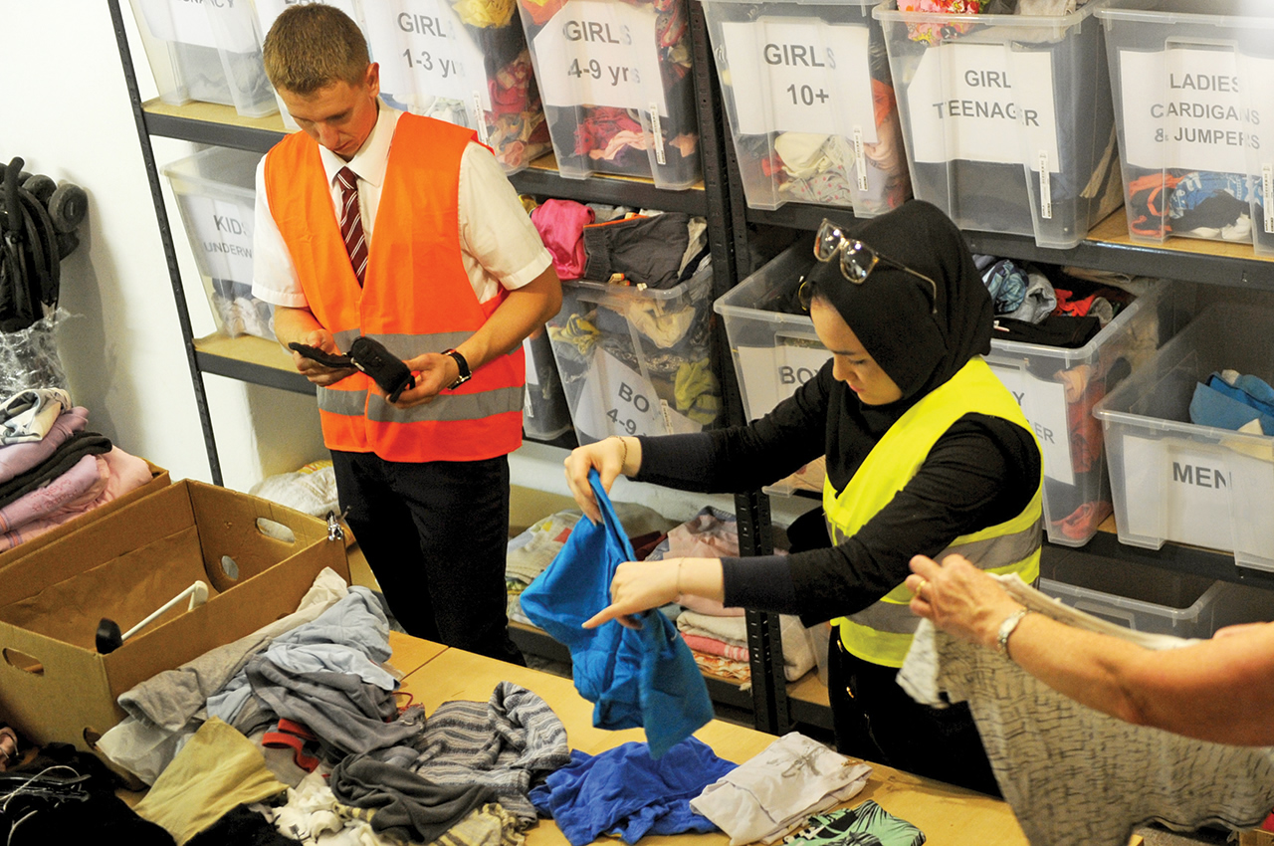
Peidio â byw iddynt eu hunain mwyach
Live no longer for themselves

Slide 6
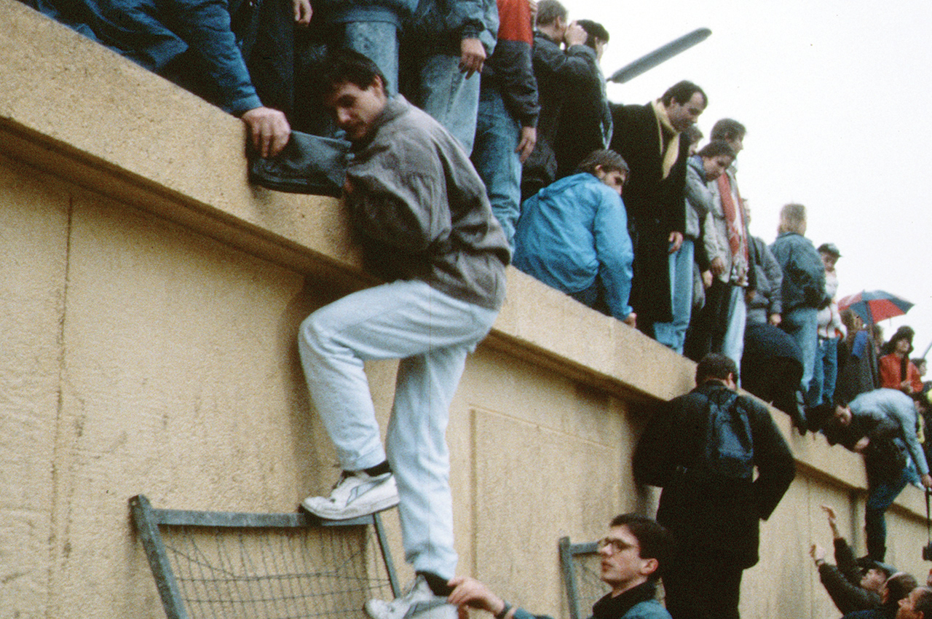
Cwymp Mur Berlin
Fall of the Berlin Wall

Slide 7
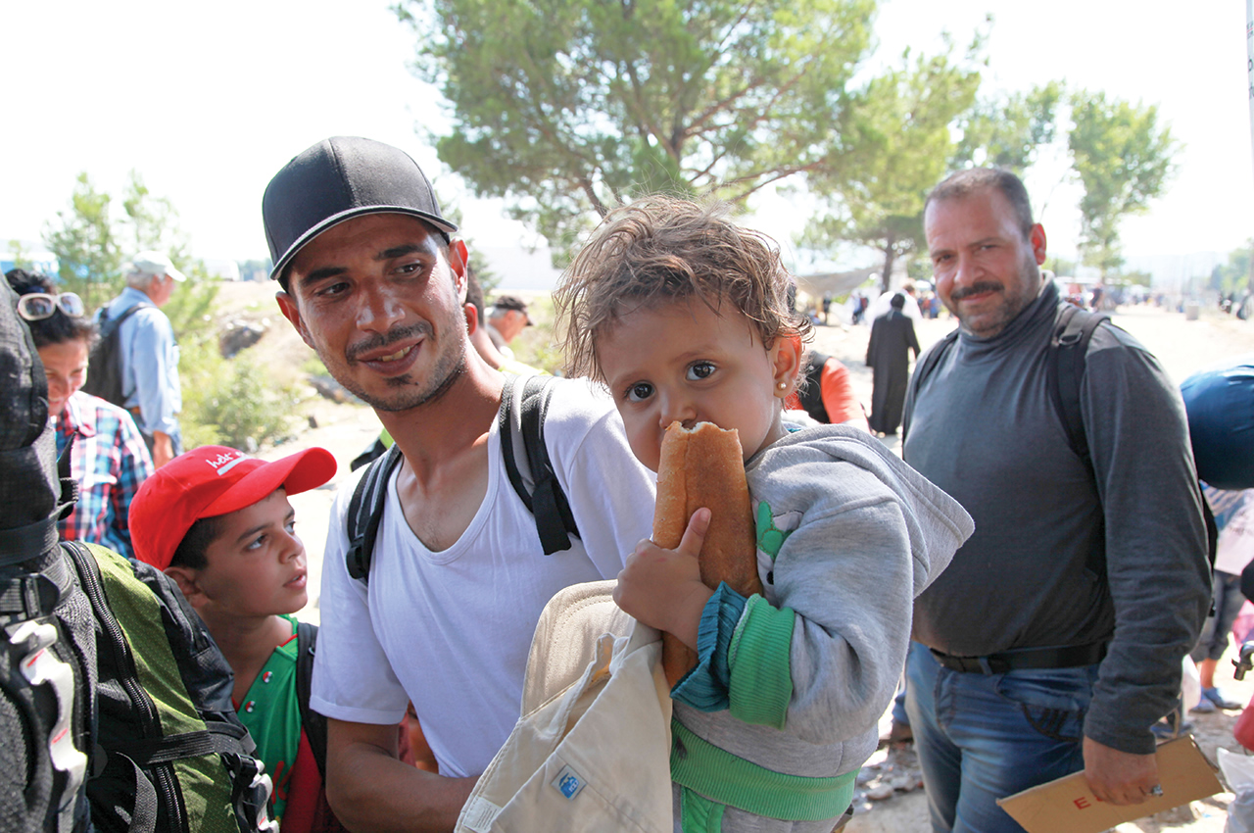
Nid ydym yn ystyried neb o safbwynt dynol
We regard no one from a human point of view

Slide 8
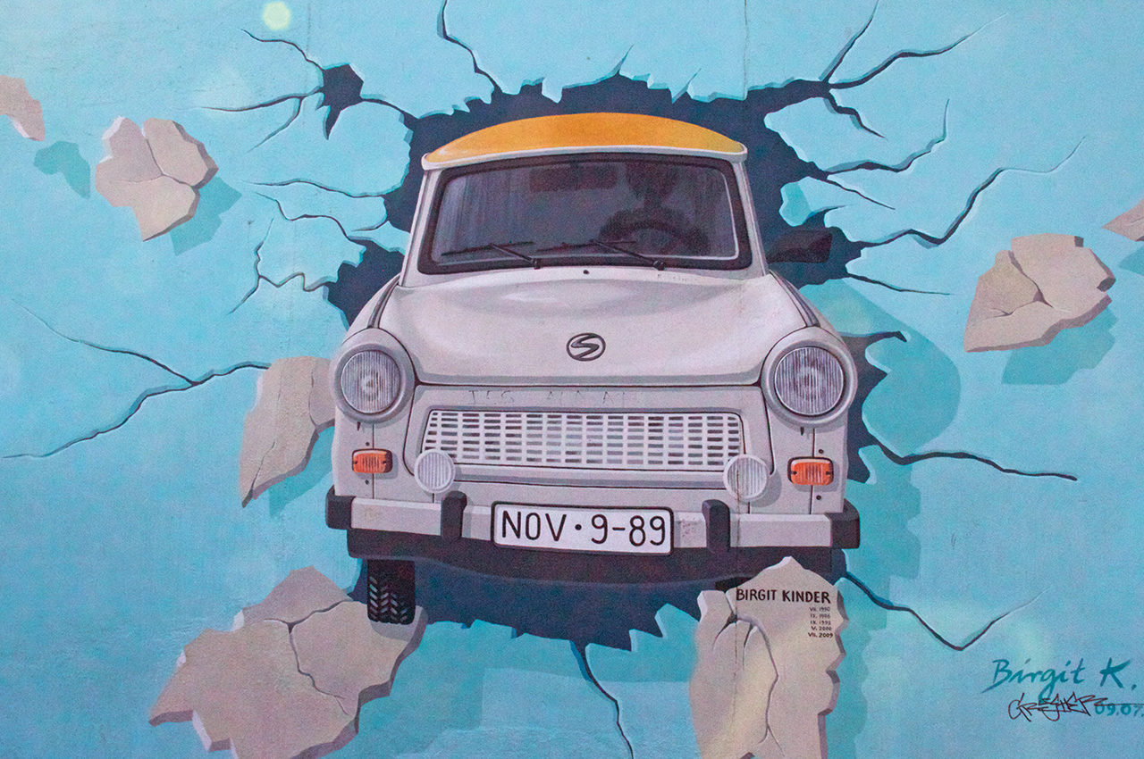
Celf Mur Berlin
Berlin Wall art

Slide 9
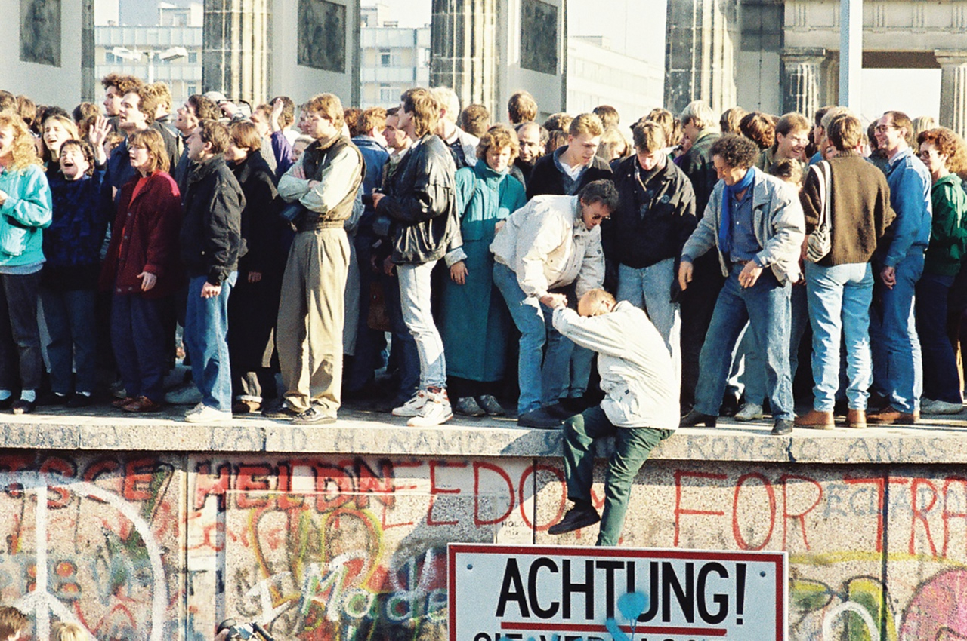
Porth Brandenburg adeg cwymp Mur Berlin
Brandenburg Gate during fall of Berlin Wall
Aeth yr hen heibio
Everything old has passed away

Slide 10
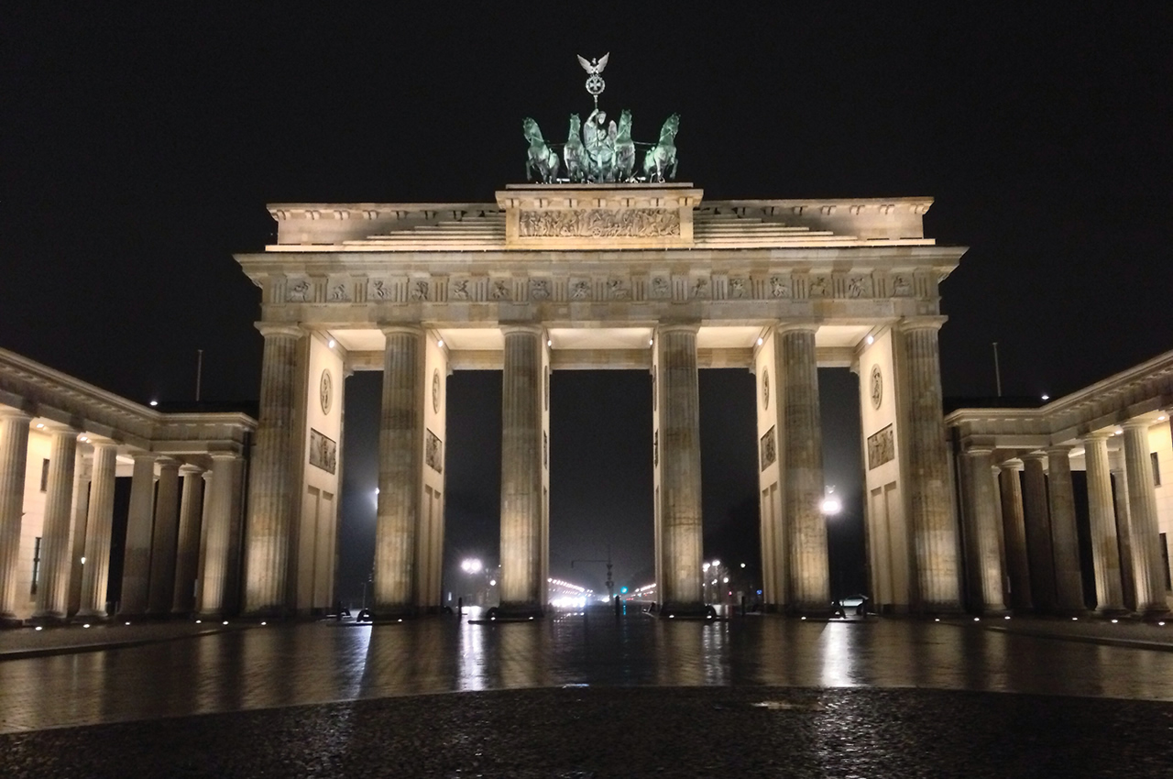
Porth Brandenburg heddiw
Brandenburg Gate today
Mae’r newydd yma
Everything has become new

Slide 11
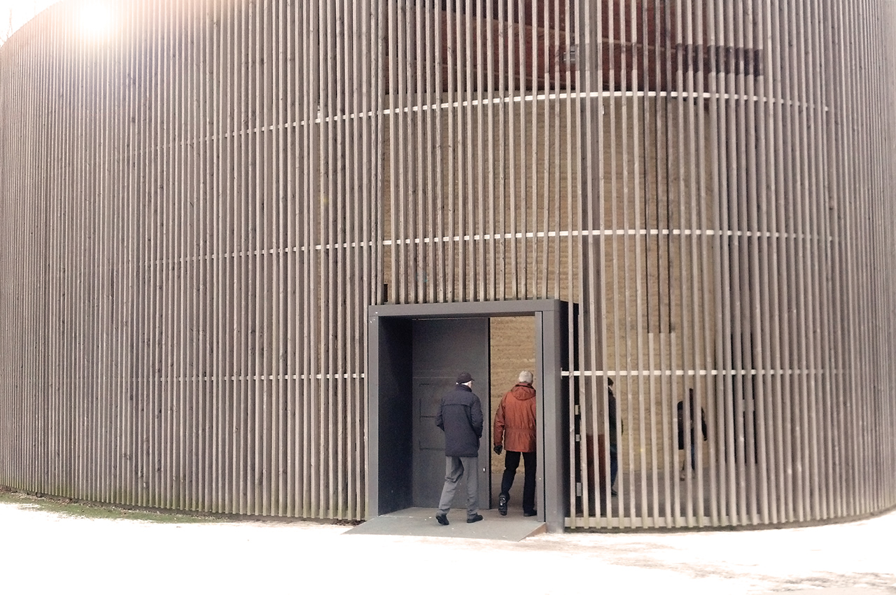
Duw, yr hwn sydd wedi ein cymodi ni ag ef ei hun
God reconciled us to himself
Capel Cymod, Berlin
Chapel of Reconciliation, Berlin

Slide 12
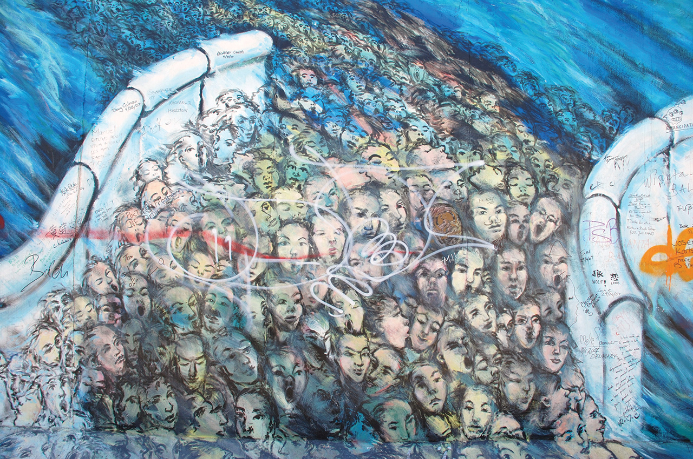
Y gweinidogaethau cymodi
The ministries of reconciliation
Celf Mur Berlin
Berlin Wall art

Slide 13
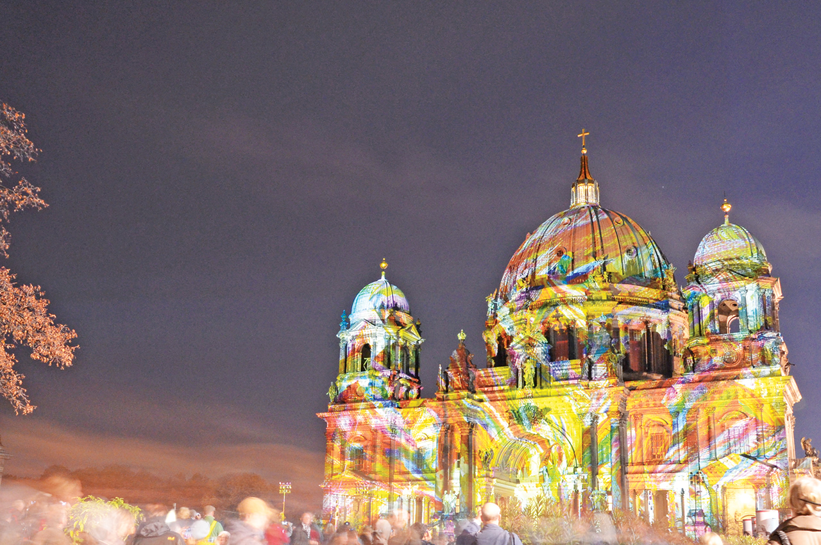
Cadeirlan Berlin yn ystod Gŵyl y Goleuni
Berlin Cathedral during the Festival of Light
‘Wedi ein cymodi â Duw’
‘Reconciled to God’

Slide 14
Clodrestr Ffotograffau / Photo credits
Jeff Keyzer
US Govt work
Rory Finneren
jchapiewsky
Sue Ream
Tanya Hart
CTBI
Raphaël Thiémard
CTBI
winnern
Stacey MacNaught
Janet Swisher
Steve Wilson
marcus.liefeld

