Slide 1
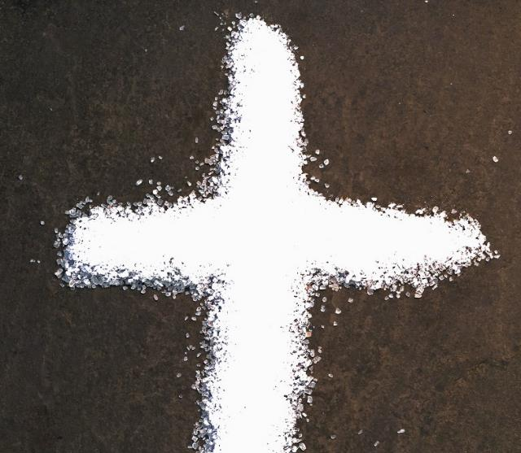

Week of Prayer for Christian Unity 2016

Slide 2
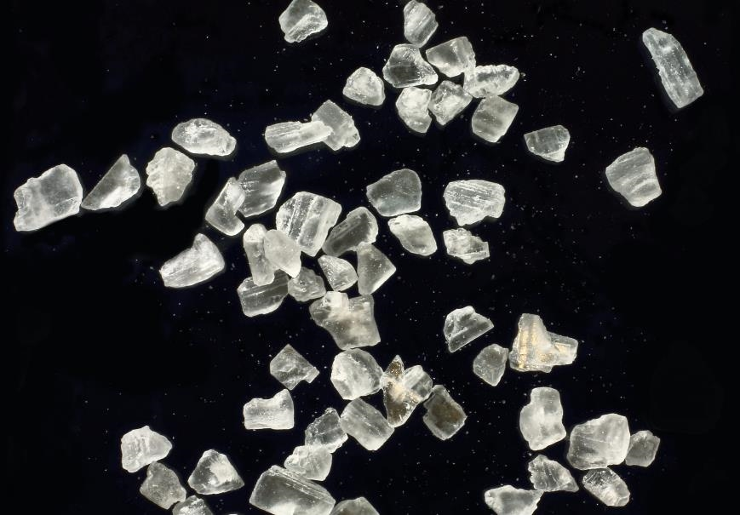
Salt of the Earth

Slide 3
The font in the nave of Riga’s Lutheran Cathedral

Slide 4
Let the stone be rolled away

Slide 5
Riga’s Roman Catholic Cathedral and ‘Barikades’ memorial to 1991 confrontations against Soviet troops

Slide 6
Called to be heralds of joy

Slide 7
The Sanctuary in Riga’s Roman Catholic Cathedral

Slide 8
The witness of fellowship

Slide 9
The cross on the site of St Meinhard’s Church, Ikskile

Slide 10
A Priestly People called to Proclaim the Gospel

Slide 11
Ruins of St Meinhard’s Church, Ikskile, the first masonry building in Latvia

Slide 12
Archbishop of Canterbury, Justin Welby, with Cardinal Vincent Nichols
Listen to this dream

Slide 13
Ruins of St Meinhard’s Church, Ikskile, the first masonry building in Latvia

Slide 14
Hospitality for Prayer

Slide 15
Russian Orthodox Church, Riga

Slide 16
Hearts burning for unity

Slide 17
Cloisters of Riga’s Lutheran Cathedral

Slide 18
The Fellowship of the Apostles

Slide 19
Week of Prayer for Christian Unity 2016
Salt of the Earth

Slide 20
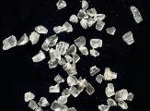
Week of Prayer for Christian Unity 2016
Photo credits
(where not provided by the Britain and Ireland writers group)
krheesy
James Emery
Jimmy and Sasha Reade
Holy Trinity Brompton
Holy Trinity Brompton
Holy Trinity Brompton
Richard Gillin
Moreno Berti
Tim Sackton

